Slide 1
Grant Writing USA
Introduction
Instructor: Andy Anderson

Slide 2

-
Learning how to swing the clubs

Slide 3
First Some Glossary!
Page 50

Slide 4
501(c)3 Nonprofits
Basically Only Two Sources of Grant Money in the United States
FG & RP
Federal Government (or state or local government)
  Allocated by congress/elected officials
  Comes from taxpayers?
Rich People
  Comes from proceeds of businesses

Slide 5
Two Types of Charitable Organizations recognized by IRS Under 501(c)3
Nonprofits – Set up primarily to solicit and receive money for the community benefit
  Can receive donations from individuals
  Can receive donations from Foundations
Foundation – Also set up to gather and give money for community benefit, the difference is….
  Public charities are understood to perform charitable work, while private foundations support the work of public charities.
  The bulk of donations generally come from a single source: i.e. rich people, rich families, communities or corporations.
  Foundations typically only donate to recognized 501(c)3 organizations

Slide 6
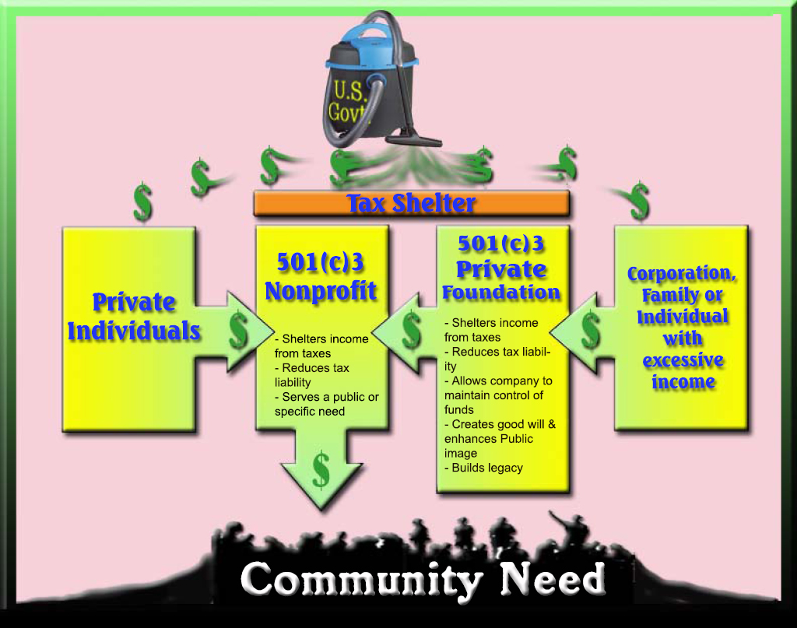

Slide 7
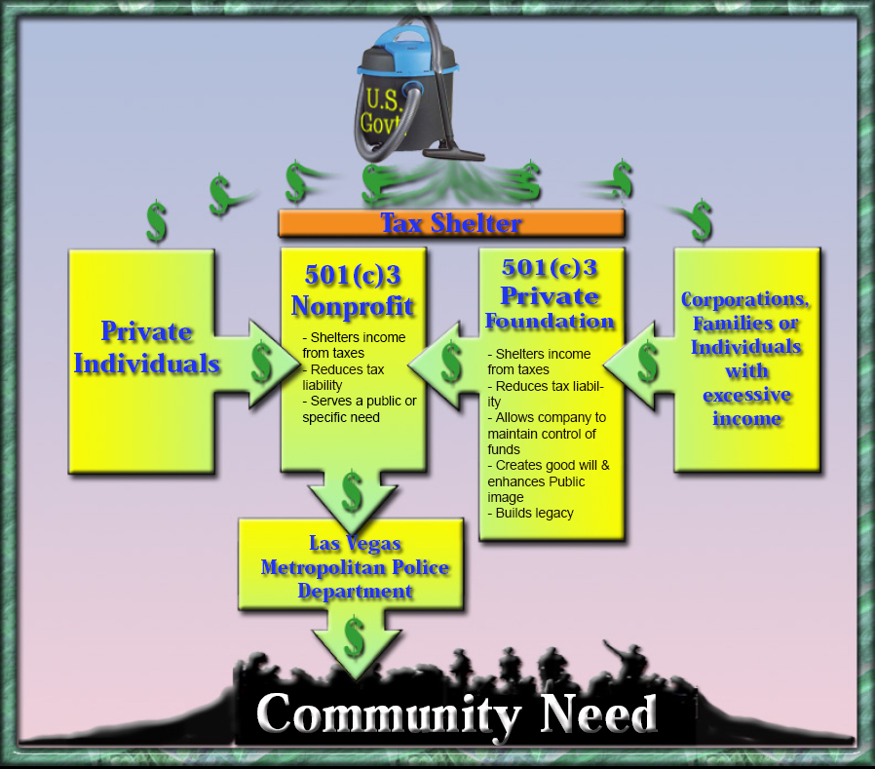

Slide 8
Tax Filing Requirements
All private foundations, regardless of revenue, must file Form 990-PF each year
Public charities have 3 possible tax filing requirements, depending on annual revenue
  Form 990 (> $200,000),
  Form 990-EZ ($50,000 to $200,000)
  Form 990-N e-postcard (<$50,000).

Slide 9
Other Examples
Clark Co Education Foundation
Emergency Services Foundation (esfweb.org)

Slide 10
Setting Up a Nonprofit
Incorporate in your state as a nonprofit
    Usually through secretary of state
Submit application and fee to IRS
    www.irs.gov
    Form 1023 ($450) or
    Form 1023EZ ($250)
Good resources!
  www.nolo.com
  www.501c3.org

Slide 11
Challenge Grant
A grant offered as an incentive to raise additional monies first.
Not the same as “match”.

Slide 12
Community Foundations
A tax-exempt, nonprofit, autonomous, publicly supported, philanthropic institution composed primarily of permanent funds established by many separate donors for the long-term diverse, charitable benefit of the residents of a defined geographic area.

Slide 13
Corporate Foundation and Giving Programs
Look for companies that have a presence in your community
Go to their website and check out their corporate giving link.
  May be called Corporate Responsibility, Corporate Philanthropy, Community Funding, Community Giving, etc.
Find out who and what they fund.
Typically corporate foundations give only to nonprofits, but there are some exceptions.

Slide 14
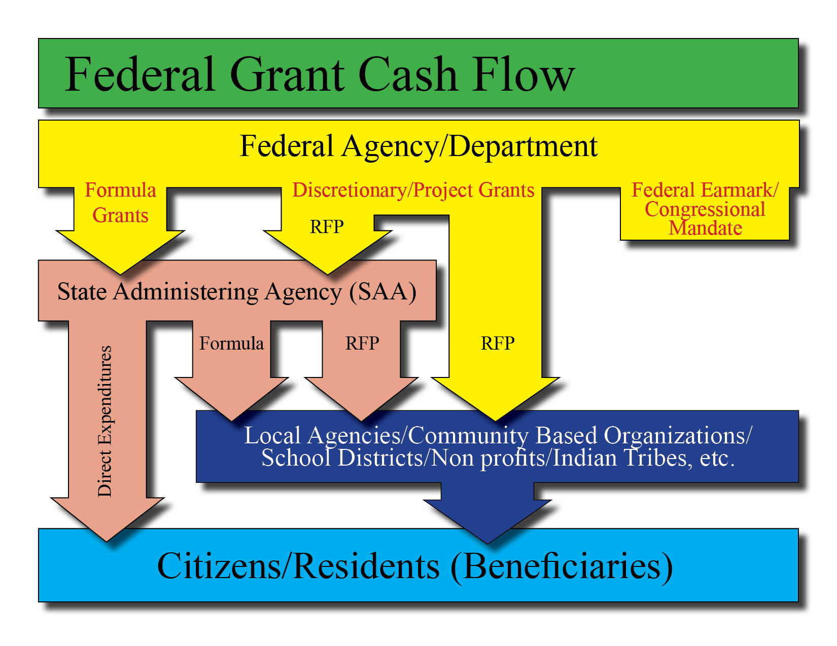






Slide 15
Types of Federal Grants
Block grants: Money given for a fairly broad purpose with few strings attached.
  Substance Abuse Prevention and Treatment Block Grant
  Community Development Block Grant
  Energy Efficiency and Conservation Block Grant
  Social Services Block Grant
  Temporary Assistance to Needy Families
  Indian Housing Block Grant
  Community Mental Health Services Block Grant

Slide 16
Types of Federal Grants
Categorical grants: Money given for a specific purpose that comes with restrictions concerning how the money should be spent. There are two types of categorical grants:
  Project grants: Money states apply for by submitting specific project proposals
  Formula grants (entitlement): Money given to states according to a mathematical formula

Slide 17
10 Largest Federal Formula Grant Programs
Medicaid;
Highway Planning and Construction;
Welfare (Family Assistance Grants under TANF);
Title I Local Education Grants;
Special Needs Education Grants;
Head Start, early childhood education;
National School Lunch Program;
Title IV-E Foster Care programs;
Women, Infant and Children’s nutrition program (for low-income pregnant women and infants); and
State Children’s Health Insurance Program

Slide 18
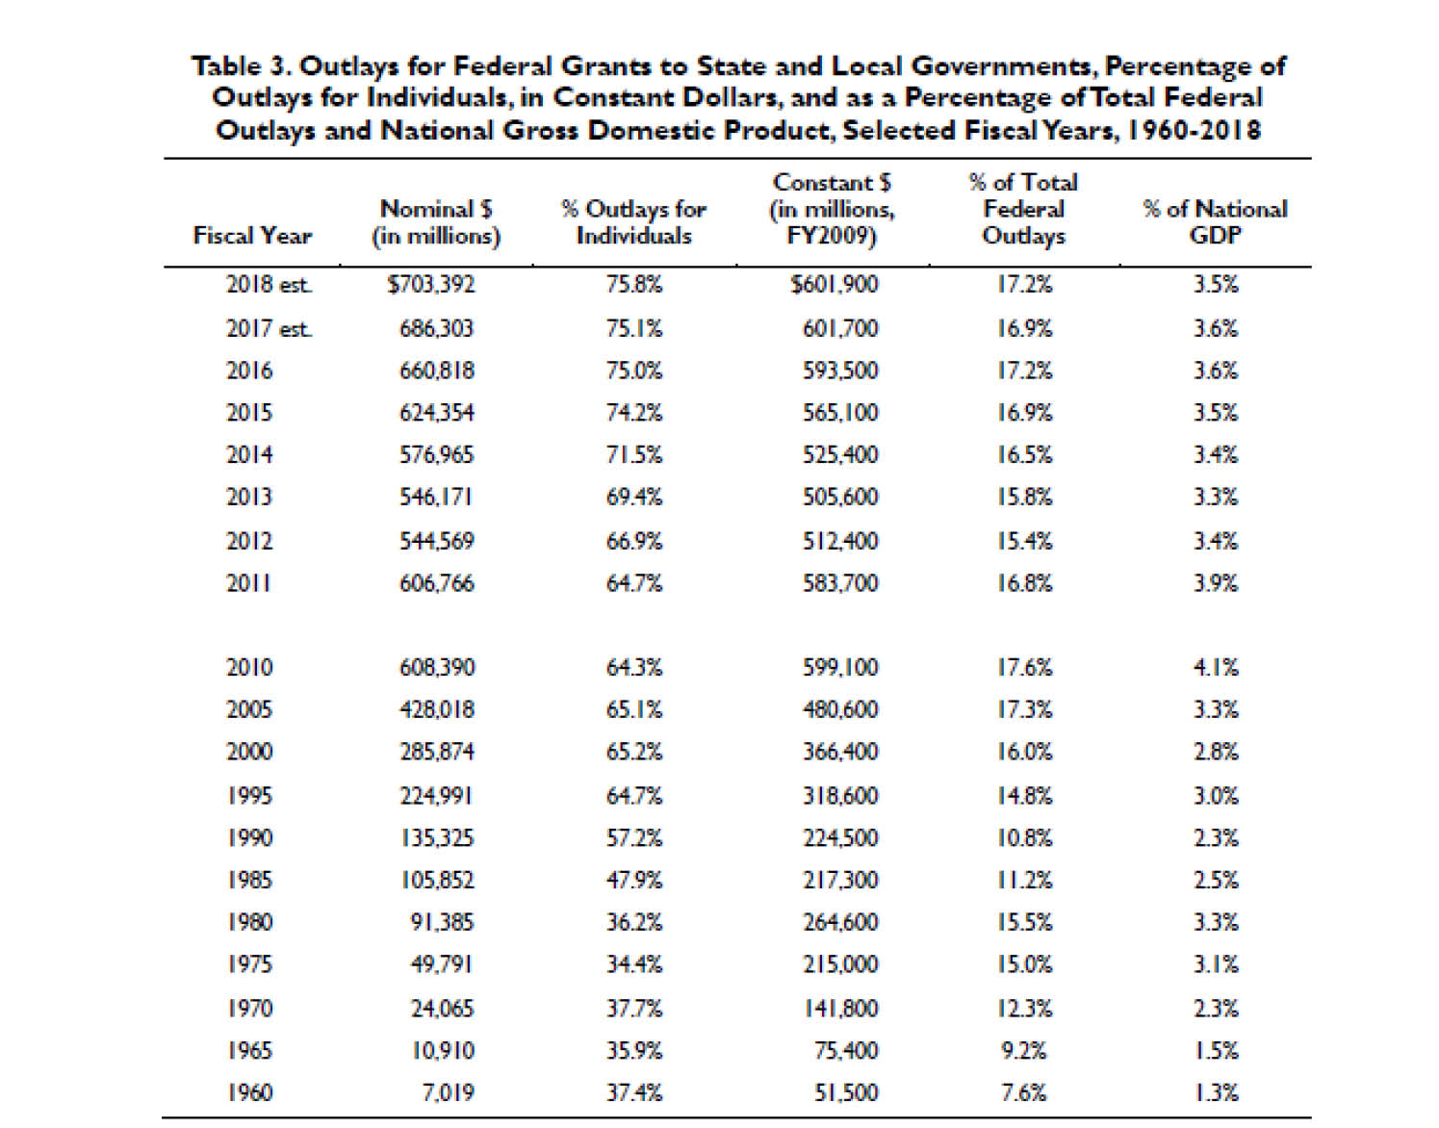

Slide 19
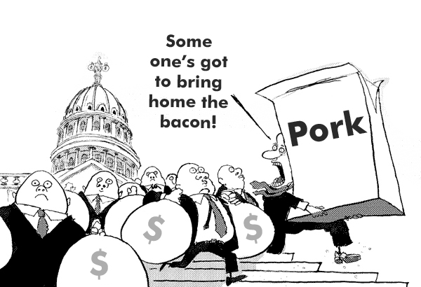

Slide 20
Donor Advised Funds
Funding given to a granting agency by a donor with specific instructions on what the money is to be used for.
Common within Community Foundations.

Slide 21
DUNS Number
Required before receiving any federal contract.
I’ll explain what it is why you need one, and how to apply for one tomorrow.

Slide 22
Entitlement Grants
Mandatory or formula grants given to states and state agencies by federal government agencies.

Slide 23

Free Money?

Slide 24
Funding Cycle
How long does it take to write a grant?
How much time between the RFP release date and the proposal due date?
How much time can you devote to writing proposals?
Anticipate deadlines by looking at the funding cycles of the grants you are interested in.
Begin working on next year’s proposal using last year’s RFP!

Slide 25
In-Kind Contributions
Anything of value contributed to the grant project.
Can often be used as “match” in federal grants that require it. More on this tomorrow in Budgets

Slide 26
Other Documents
Letter of Intent (LOI)
Letter of Inquiry (Query letter)
  Preliminary Proposal
  Guidelines on Page 54

Slide 27
Operating or General Support
Perhaps the hardest money to get!
Why?
Have you ever felt like this guy when seeking operating funds?

Slide 28
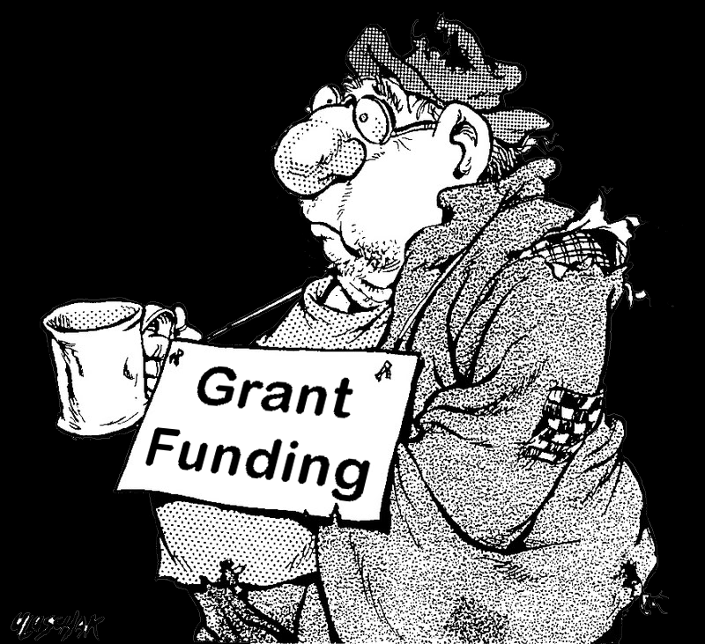

Slide 29
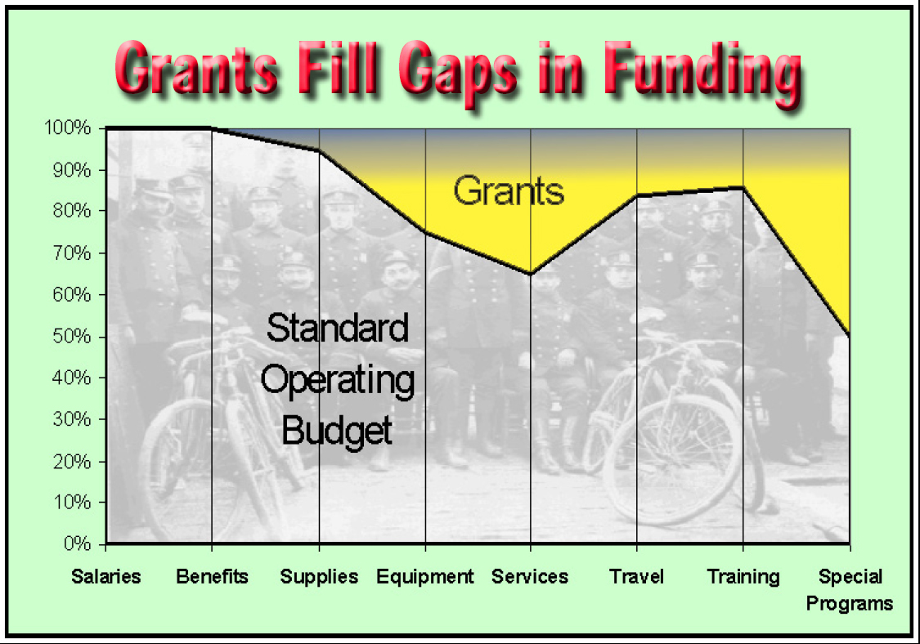
What are Grants For?
Then what are grants to be used for?

Slide 30
Organizations that “make it” usually find some source of soft money that frees them from total reliance on grants for their general operating costs.

Slide 31
Request for Proposals (RFP)
RFP: Request for proposals,
SGA: Solicitation for Grant Applications
NOFA: Notice of Funding Availability
FOA: Funding Opportunity Announcement
CFP: Call for Proposals or Call for Papers

Slide 32
Programmatic Requirements of the RFP
What do you propose to do?
How do you propose to do it?
Who will be involved?
How much will it cost?
What are the expected outcomes?
Etc.

Slide 33
Technical Requirements of RFP
Who can apply - Eligibility
Submission Deadline
Format of proposal
  How many pages or words or characters
  Font and font size
  Margins and spacing
Signatures
Certifications and Assurances
Attachments

Slide 34

Tim “the Tool Man” Taylor
Directions are:
“Just one person’s idea of how something ought to be done!”

Slide 35

Critical Advice
Read RFP immediately and thoroughly
Put everyone who will contribute on notice
  Resumes
  Support letters
Begin doing anything you can do on day one
  Addressing envelopes
  Filling out the application
  Gathering attachments
  Etc.

Slide 36
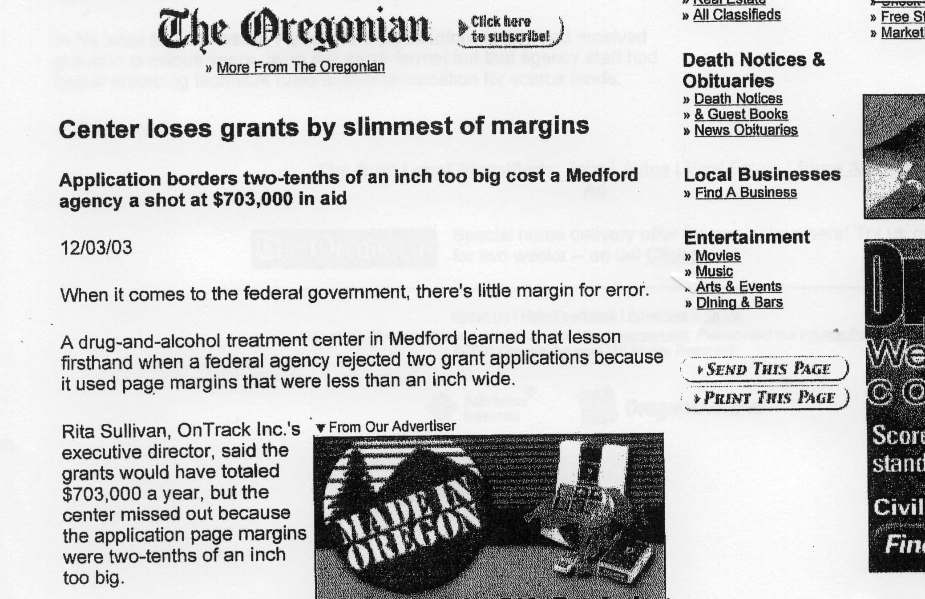

Slide 37
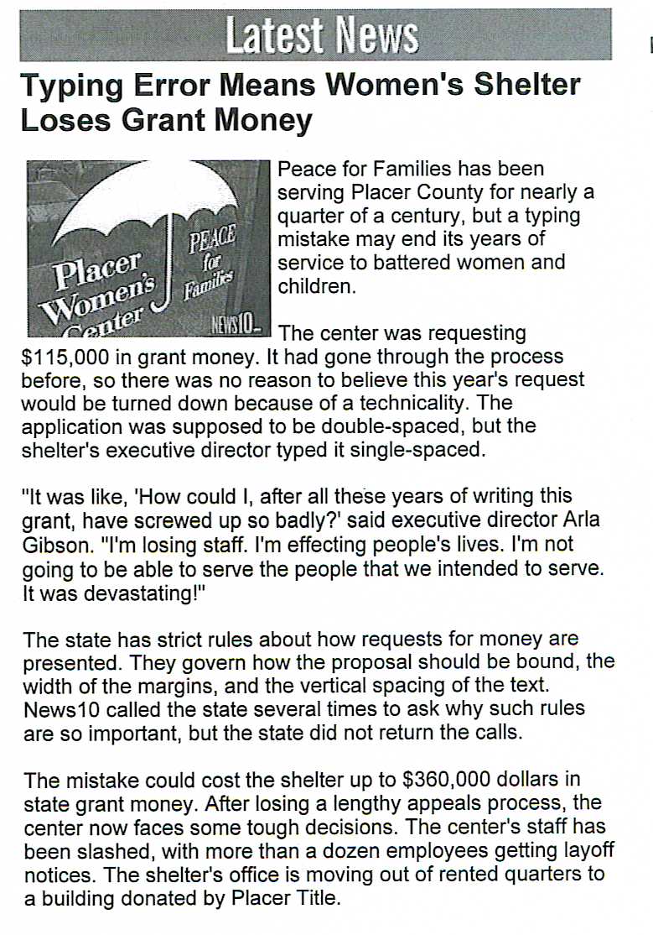

Slide 38
The Great Cull
Upwards of 60% of all proposals are bounced in technical review either because:
  the applicant was not eligible to apply, or
  they failed to follow RFP guidelines.

Slide 39
What is the
1st Rule of Grant Writing?
ASK!

Slide 40
Some Corollaries
If you help other people get what they want, you’re more likely get what you need.
Always seek for, and focus on, the greater good!

Slide 41
Quick Overview
Work Book
  Writing Exercises: Space for you to begin composing your proposal in each chapter
Core Components of a Grant Proposal
  Page 58

Slide 42
Core Components of a Grant Proposal
1. Who are you and why are you exceptional? (Credibility Statement/Statement of Introduction)
2. What measurable problem or need are you focused on? (Problem Statement or Assessment of Need)
3. How much impact on the problem or need will you have? (Measurable Objectives)
4. How will you accomplish the impacts (Methods)
5. How will you evaluate your methods and impacts? (Evaluation Plan)
6. How will you spend the money? (Budget)

Slide 43
Big Disclaimer!
You should do what we talk about, and what you learn in this class in lieu of specific instructions from the grant funder...however…
…if the grant maker gives you different instructions, always do it their way!

Slide 44
Statement of Introduction
Chapter 1 - Page 4

Slide 45

FEMA SAFER Grant
(Staffing for Adequate Fire & Emergency Response)

Slide 46
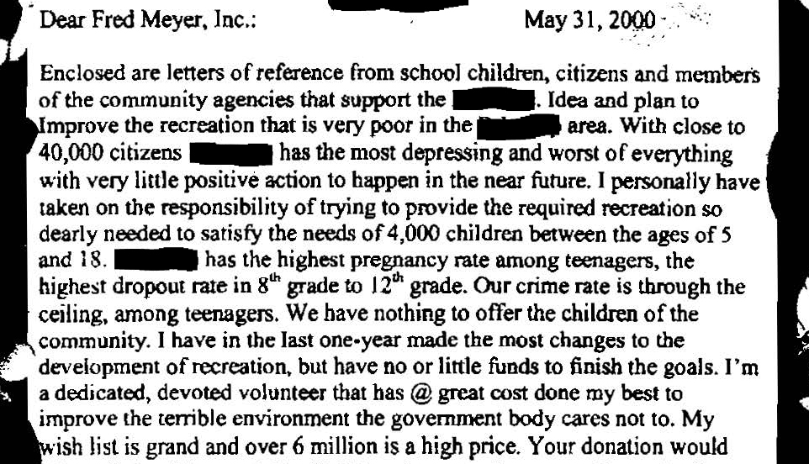

Slide 47
Attributes of Money
Money congregates.
Money creates gravity that attracts other money to it.
Money is subject to inertia. Sometimes hard to get it moving, but once in motion, it tends to stay in motion.
Money is attracted by and to success and positive and uplifting attitudes.
Money seeks out causes worthy to receive it
Money often comes only after the organization is fully prepared and ready to receive it.

Slide 48
How do you develop credibility?
Identify and research prospective funders in advance.
Become familiar with their mission, goals and priorities.
Determine what types of programs they have funded in the past.
Make sure your missions are congruent.
  k

Slide 49
What to include in your introduction!
Your organization’s history.
Anything unique about your organization.
  Location, size, demographics, & challenges
Key staff or board member biographies.
Significant accomplishments to date.
  What if you’re a new organization?
Success stories.
Other financial support you’ve received.
Letters of support/endorsement.
Affiliations and Accreditations.
Annual Plans (if you have one).
A link to your website.
k

Slide 50
Where do you get information to put in the credibility section?
First Assignment!
You create a credibility resume’ or credibility file!
k

Slide 51


Credibility File
Letters of support
Letters of thanks
Letters of commendation
Newspaper/magazine articles
Transcriptions from TV/Radio interviews
Statements extracted from social media
Etc.

Slide 52
Question?
What if you don’t have anything to put in your credibility file?
Refer to the first rule of grant writing…
Ask!

Slide 53
Types of Support:
Letters of support.
Letters of endorsement.
Contracts.
Memorandums of Understanding (MOUs).
All this support is based on Relationships.
  Cultivate those relationships now!
k

Slide 54
When writing your credibility statement…
Be brief.
Be specific.
Avoid Jargon.
  Find a proposal “Buddy”
Keep it simple.
Create and save different versions of basic credibility information that you can tweak and paste into future proposals.
k

Slide 55
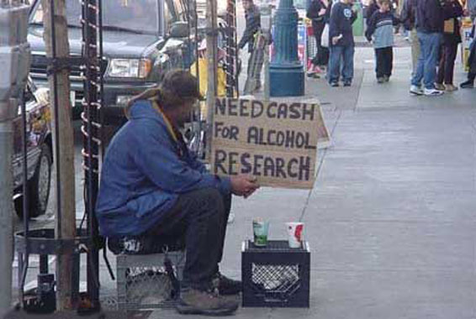
Who’s credible?

Slide 56

Credibility Statement
Example – Page 8

Slide 57
Introduction Writing Exercise
Page 9

Slide 58
Problem Statement/Needs Assessment
Chapter 2 – Page 10

Slide 59
The Problem Statement:
Should refer to needs outside of your organization.
  Exception: “Capacity Building” grants
Does not describe your “lack of money” as the problem.
  k

Slide 60
Chasing Money vs. Changing the World
Who will benefit most?
  You or Client?
Is the issue related to your mission?
Is there a logical connection between what you do now and what you will do after you receive the money?
Will receipt of funding cause a major shift in your operations?

Slide 61
Assessing the Needs
Formal Assessments
  Surveys,
  Development of Strategic Plans,
  Detailed analysis
Informal Assessments
  Observations
  Anecdotal records
  Interviews

Slide 62
Where to Find Data to Document Need
Formal Sources
  #1 Tip: Just Google “__________ data”
  Federal, state and Local government agencies
    Local vs. national?
  Universities and colleges
  501c3 Foundations
Informal Sources
  Testimonies from the actual people who are experiencing the problems or needs.
    wtw

Slide 63
Problem statement should include:
How you came to realize the problem exists.
The nature of the problem
  provide as much hard data as possible.
Who does the problem affect and how they’ll benefit if you are funded.
What will happen if the project is not funded.
The current social and economic costs to the service area and…
The Return on Investment (ROI).
k

Slide 64
Is it a Problem or Need?
Problem Statement
  Something undesirable is currently occurring
Vulnerability Assessment (Homeland Security)
  If something were to occur…
Needs Assessment
  Current programs or services are falling short of addressing the problem
  Might also refer to cultural, artistic, spiritual or value oriented issues
Needs vs. Problems
  k

Slide 65
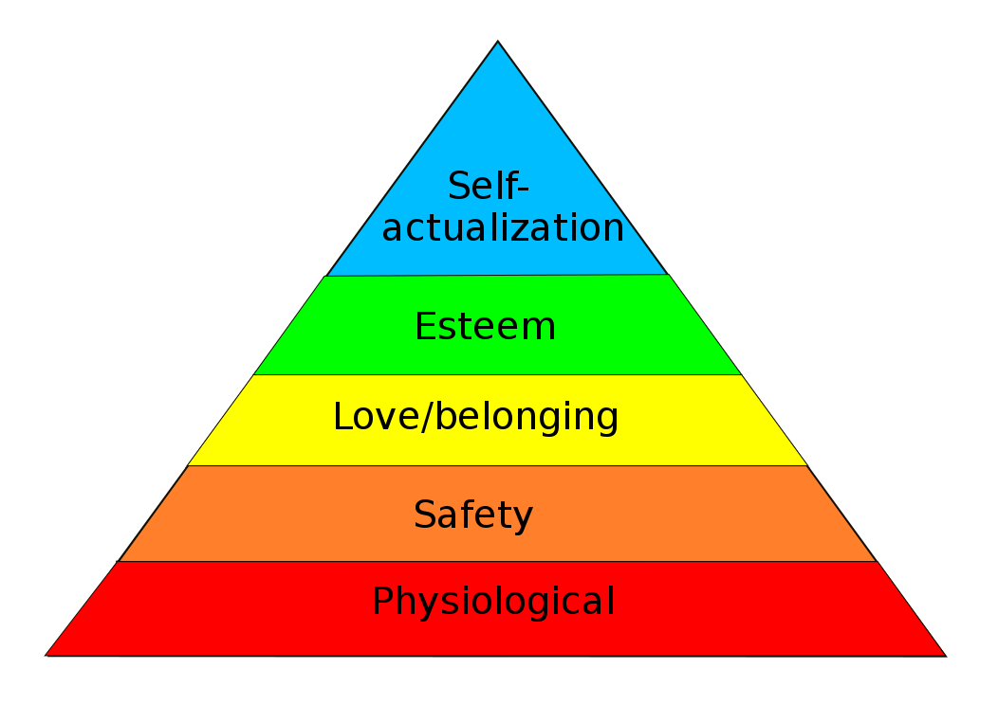
Every issue should be somehow tied to basic human needs!
Maslow's hierarchy of needs

Slide 66
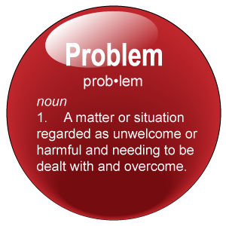
Can you Distinguish the Problem from the Method?
Grants Map Exercise

Slide 67
Introducing the Grants Map
Why I’m Applying…
Problem/Need
Method/Solution
External
Internal
Objective
Subjective
Find a blank page in your book and let’s start mapping!

Slide 68

Speeding Motorists
Example – Page 12

Slide 69
I want to stop speeding on my street
Safety of Children and pedestrians
Potential damage to property
Threat to house pets
Noise
Pollution
Officer
Speed bumps
Calming cones
Off duty officer
Ignition zappers in road
Problem/Need
External
Objective
Supported by Evidence (accidents, injuries, tickets, complaints, etc.)
Method/Solution
Internal
Subjective

Slide 70

Beware!
If you find yourself using “lack of” statements, check it carefully, you’re probably talking about lack of a method.

Slide 71
The Grantor will want to know…
What is the problem or need being addressed?
Who benefits from the proposed solution? (clients or the agency applying?)
Will the proposed efforts actually have an effect on the problem?
Can the problem be addressed in a realistic time frame?
Remember why we’re here!
k

Slide 72

Problem Statement
Example #1 – Page 14

Slide 73
Example #2 – Page 16
Defines aggressive driving
  AAA definition
  New York State Definition
Explains factors impacting aggressive driving
  Smartmotorist.com (the roads themselves, number of drivers, etc.)
Documentation of local situation
  Motorist Surveys
  911 calls and complaint data
Current response to situation
Proposed response when funded by grant

Slide 74
Problem Statement/Needs Assessment Writing Exercise
Pages 18-19

Slide 75
Goals and objectives
Chapter 3 – Page 20

Slide 76
Goals
Goals tend to be big picture visions.
  Save the whales!
  Improve the environment!
  Stop teen pregnancy!
  Reduce highway fatalities!
Goals generally describe the way we wish the world to be.
k

Slide 77
Objectives
Objectives are measurable, narrower in scope than the goals and more concrete,
Objectives are the specific results you plan to achieve during the grant period, and ….
Objectives are often “Observable”.
k

Slide 78
For example, our goals are to:
Reduce crime by 20% by the end of December 2022.
Increase arrest rates by 19% by March 2020.
Engage citizens to increase crime reports by 32% between 2021 and 2023.
Institute a commercial business program to educate 60% of retail businesses about proper means to deter shoplifters by end of 2023.
Increase police department by 12 officers at the end of 10th year to increase department’s ability to combat growing crime rate.

Slide 79
This is the way we wish the world to be…
Reduced crime,
Increased arrest rates,
Engaged citizens reporting crimes,
Businesses knowing how to deter shoplifters, and…
12 more police officers on the job.

Slide 80
…but, to turn goals into objectives, we must include:
Who?
What?
When?
How much?
How measured?

Slide 81
For example…
“Reduce crime by 20% by the end of December 2022” now becomes….
Anytown USA will reduce crime by 20% at the completion of the program in 12/2022. This will be measured by crime statistics collected by Anytown Police Department. Crime data collected in 2018 will be used as the baseline data for comparison. In 2018, 382 crimes were reported in Anytown

Slide 82
Two Types of Objectives
  Process Objectives
  Outcome Objectives
  k

Slide 83
Process Objectives
Process Objectives reveal and measure your proposal methods.
  They describe the activities, services and strategies to be delivered when you implement the program.
  Process objectives by their nature are generally short term.
  Process objectives are typically “observable”.
  k

Slide 84
Outcome Objectives
Outcome Objectives are your promised improvements in the situation you described in the problem statement.
  They describe the intended effect or end result of the program.
  Outcome objectives focus on what your target population(s) will know or will be able to do or how their world will be different as a result of your program/activity.
  Outcome objectives generally reflect long term effects
  k

Slide 85
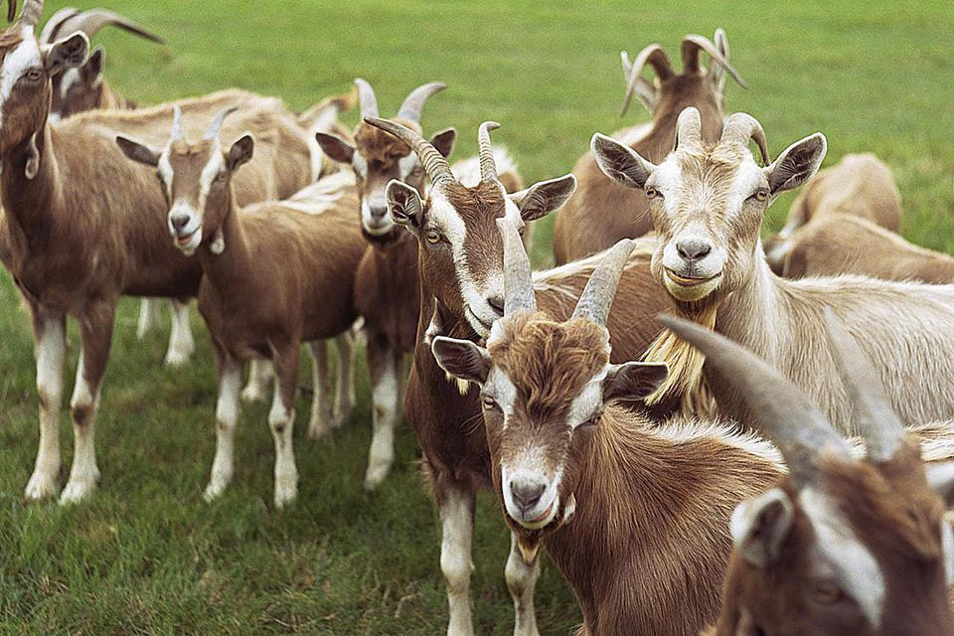

Slide 86
Why I’m Applying
Problem/Need
Method/Solution
External
Internal
Objective
Subjective
Outcome Objectives
Process Objectives
(Outcomes)
(Outputs)

Slide 87
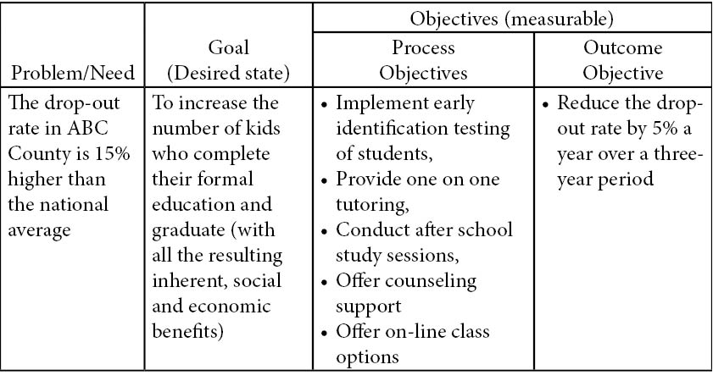
How do Process and Outcome Objectives fit within a proposal? (page 22)

Slide 88
Which are Process Objectives and which are Outcome Objectives?
Reduce crime by 20% by the end of December 2022.
Increase arrest rates by 19% by March 2020.
Engage citizens to increase crime reports by 32% between 2021 and 2023.
Institute a commercial business program to educate 60% of retail businesses about proper means to deter shoplifters by end of 2023.
Increase police department by 12 officers at the end of 10th year to increase department’s ability to combat growing crime rate.
O
O
O
O
P

Slide 89
Developing good outcome objectives can be challenging!
Have you ever made up numbers when developing outcome objectives?
Look at precedence (past outcomes)
Ask the funder for guidance in developing good outcome objectives.
Project your agency into the future based on your strategic plan.
k

Slide 90
Goals and Objectives are the Grant Recipient’s World
Since the 1960s federal grant performance requirements have steadily increased.
GPRA Law (Government Performance Results Act) passed in 1993 (updated in 2010).
  Federal agencies are required to develop five-year strategic plans with long-term, results-oriented goals.
  Federal agencies are required to prepare annual performance goals, tell how these goals are to be met, and how they can be verified.
  Federal agencies must review and publish the agency's success or failure in meeting its goals.
Most federal RFPs were rewritten in 2000 to include goals and objectives.

Slide 91

Difference Between Process Objectives and Outcome Objectives
Scenario – Page 23

Slide 92
Objectives should be SMART
Specific,
Measurable,
Attainable/Achievable,
Realistic/Relevant, and
Timely

Slide 93
Goals and Objectives Writing Exercise
Page 24

Slide 94
Summary: Goals and Objectives should tell
Who?
Will do what?
When?
How much change will occur?
As measured by?
You’re now ready to tell the grantor how you’ll reach those goals and objectives in the Methods section…...tomorrow!

Slide 95
Methods
Chapter 4 – Page 25

Slide 96
Guidelines for Methods
Tell the grantor:
  Who will perform the tasks and what are they responsible for.
  What you will do.
  When the program be implemented? Funders want to know the program will run without or without them.
    Include a timetable; it demonstrates you have thought your program through.
  Where events will take place
  Why you believe your chosen approach is valid.
  How you will accomplish the tasks and measure the results

Slide 97
Writing to Convince
Avoid words like might, if, could, should, would, etc.
  Develop good writing/editing skills through practice.

Slide 98
Three Basic Elements of Grant Program Design
Inputs
Outputs
Outcomes

Slide 99
Inputs are the resources or assets you will bring (put in) to the methods.
These may include:
  Staff
  Volunteers
  Time
  Money
  Data
  Materials
  Knowledge
Can usually be quantified and documented to meet match requirements.
  Equipment
  Technology
  Services
  Transportation
  Experience
  Expertise
  Partners

Slide 100
Outputs are the activities or motions you’ll perform while fulfilling the methods.
You might use words like:
  Conduct
  Deliver
  Assess
  Recruit
  Develop
Again, these are often the observable elements of your proposal.
  Train
  Provide
  Facilitate
  Mentor
  Partner

Slide 101
Outcomes are the anticipated impacts, results or products of your method.
Three types of outcomes:
  Short term outcomes typically involve a change in:
    learning, awareness, knowledge, skills, opinions, aspirations and motivations.
  Medium Term outcomes usually involve a change in:
    actions, behaviors, practices, decision making, policies and social action.
  Long term outcomes typically involve a change in:
    Human conditions, societies, economies, situations, and environments.

Slide 102
Inputs – Resources we will bring to the methods we have proposed.
Why I’m Applying
Problem/Need
External
Objective
Method/Solution
Internal
Subjective
Outputs – Activities we will perform during the grant period (observable)
Outcome Objectives
Process Objectives
Long Term: Ultimate changes in the Condition or Situation we described in the problem statement above.
Medium Term: Behaviors, Practices, Actions, etc.
Outcomes – The results of our efforts
Short Term: Awareness, knowledge, etc.

Slide 103
Justifying Your Program
Highlight the innovative features of your proposal.
Research how other people have addressed similar problems.
  Nevada Partners
Mention, compare or contrast your proposal with other programs that have had prior success and show how your design emulates that success.
k

Slide 104

Task Timeline
Example – Page 28

Slide 105
Methods Writing Exercise
Page 29

Slide 106
Evaluation
Chapter 5 – Page 30

Slide 107
Two types of evaluation!
Process Evaluations focus on the way your program is conducted (the process) and is a tool to provide information necessary to make appropriate changes and adjustments in your program as it proceeds.
Outcome Evaluations measure the results, or the outcomes (the product), of your program.

Slide 108
Why I’m Applying
Problem/Need
Method/Solution
External
Internal
Objective
Subjective
Did we have an impact on the issue as we had hoped?
If not, what do we need to change to reach our desired outcomes?
Outcome Objectives
Process Objectives
(Outcomes)
(Outputs)

Slide 109
Question?
Why is effectiveness important to an organization with integrity?
What if you were 6 months into a program and you realized you were not obtaining the results you intended?

Slide 110
Subjective vs. Objective Evals
Subjective evaluations tell how people feel about the program.
  Might be subject to bias
Objective evaluations are usually based on irrefutable facts or evidence.
k

Slide 111
The top three ways to conduct your evaluation:
Do what the grant maker tells you.
Hire an outside evaluator.
Do it yourself with existing staff.
k

Slide 112
To insure good evaluations…
Clearly define your problem first.
Understand the funder’s expectations.
Incorporate pre-existing data into your program design.
Make adjustments and modifications in the evaluation if necessary and as needed.
Incorporate both formative (ongoing/process) and summative (outcome) assessments into your evaluation.
k

Slide 113
Some evaluation tools to consider:
Preferred Tools
  Quantitative/objective (usually cannot be objected to)
    Pre and post testing
    Surveys and questionnaires
    Interviews
    Activity logs
    Case reports
    Performance reports
Adds humanity and complements Quantitative data
  Qualitative/Subjective (subject to personal interpretation)
    Testimonials
    Anecdotes
    Success stories
    Observations

Slide 114
Collecting Evaluation Data
Q: What data do you collect now?
It is never too early to start collecting data associated with your problem or need.
Every grant will require you to report some type of data. It can be laborious.
  No complaining!

Slide 115
The Grantee’s never ending job of data collection!
You should be collecting data before you apply for the grant to document evidence of the problem or need.
  Either from outside sources or internally generated
You collect data during the grant period to determine if you’re on course and whether modifications or adjustments are needed.
You collect data at the conclusion of the grant program to show evidence of change.

Slide 116
Before…….During and………..After!
$
The Difference you Made in the World
Evidence of Change
You doing what you do.
Evidence of Problem/Need
Information to Trigger/Warrant Modifications

Slide 117
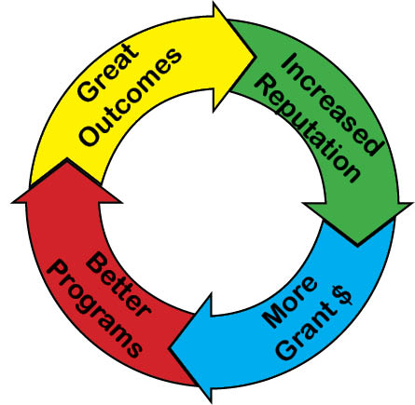
The Circle of Grant Success!
Data showing great outcomes becomes part of your agency’s history and is added to your credibility file for the next grant proposal.

Slide 118
Evaluation Writing Exercise
Page 33

Slide 119
Budgets
Chapter 6 – Page 34

Slide 120

Let’s Create a Budget!
Exercise

Slide 121
General Budget Guidelines
Base your budget on what the project requires, not what you think you can get.
Budget down to the pencil (no guesses).
No need for padding for contingencies.
  Budgets are malleable
Include all allowable costs necessary for a successful program.
Make sure each cost is reasonable and justifiable.

Slide 122

Budget Line Items
Page 35

Slide 123
Match
Typically only a requirement for federal grants
Funder will tell you what percent you will be required to contribute
Many ways to meet match requirements.
In-kind contributions can only be counted to the extent that they benefit the grant.

Slide 124
Indirect Costs
Typically applies only to Federal grant programs
Funder may cap the rate allowed
OMB Super Circular
  Ask about the 10% “de minimis” indirect cost rate if you are a non federal organization or have never had an approved indirect cost rate.

Slide 125
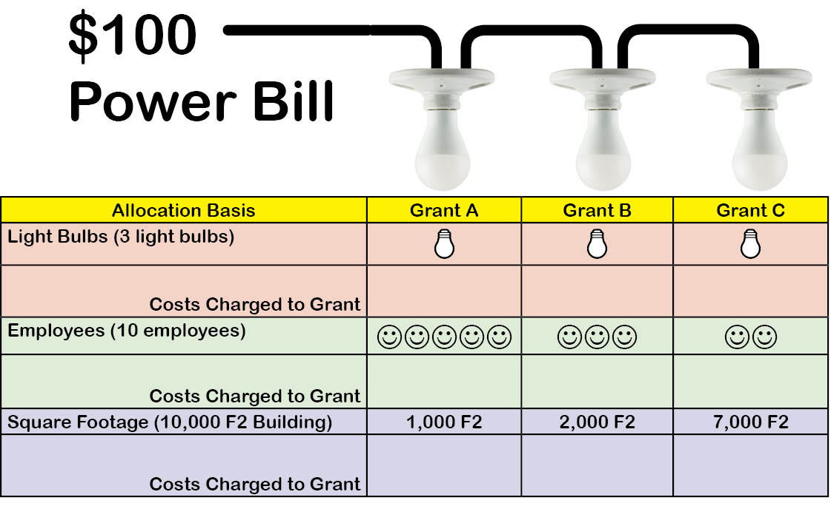
Cost Allocation Theory
$33.33
$33.33
$33.33
$50
$30
$20
$10
$20
$70

Slide 126
Sustainability
Keep a portion of the program viable even if some of it cannot be funded.
Begin charging for previously free services.
Monetize some aspect of your organization. (Is there money hidden somewhere in what you do?)
Develop sources of soft funding and use to sustain.
k

Slide 127
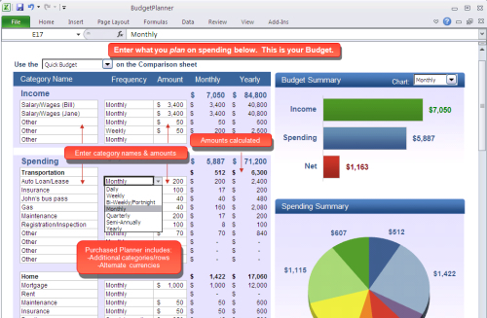
Budget Formats
Page 41

Slide 128
Budget Narrative
Typically a separate document required by the funder as part of your proposal
Break out into smallest detail
  Name of the item
  Purpose of the item
  Cost of the item

Slide 129
Budget Worksheet Exercise
Page 45

Slide 130
Supplanting
Supplanting can be criminal.
Supplanting may result in disallowed costs which must be repaid.
Most audit findings are related to the supplanting issue.

Slide 131


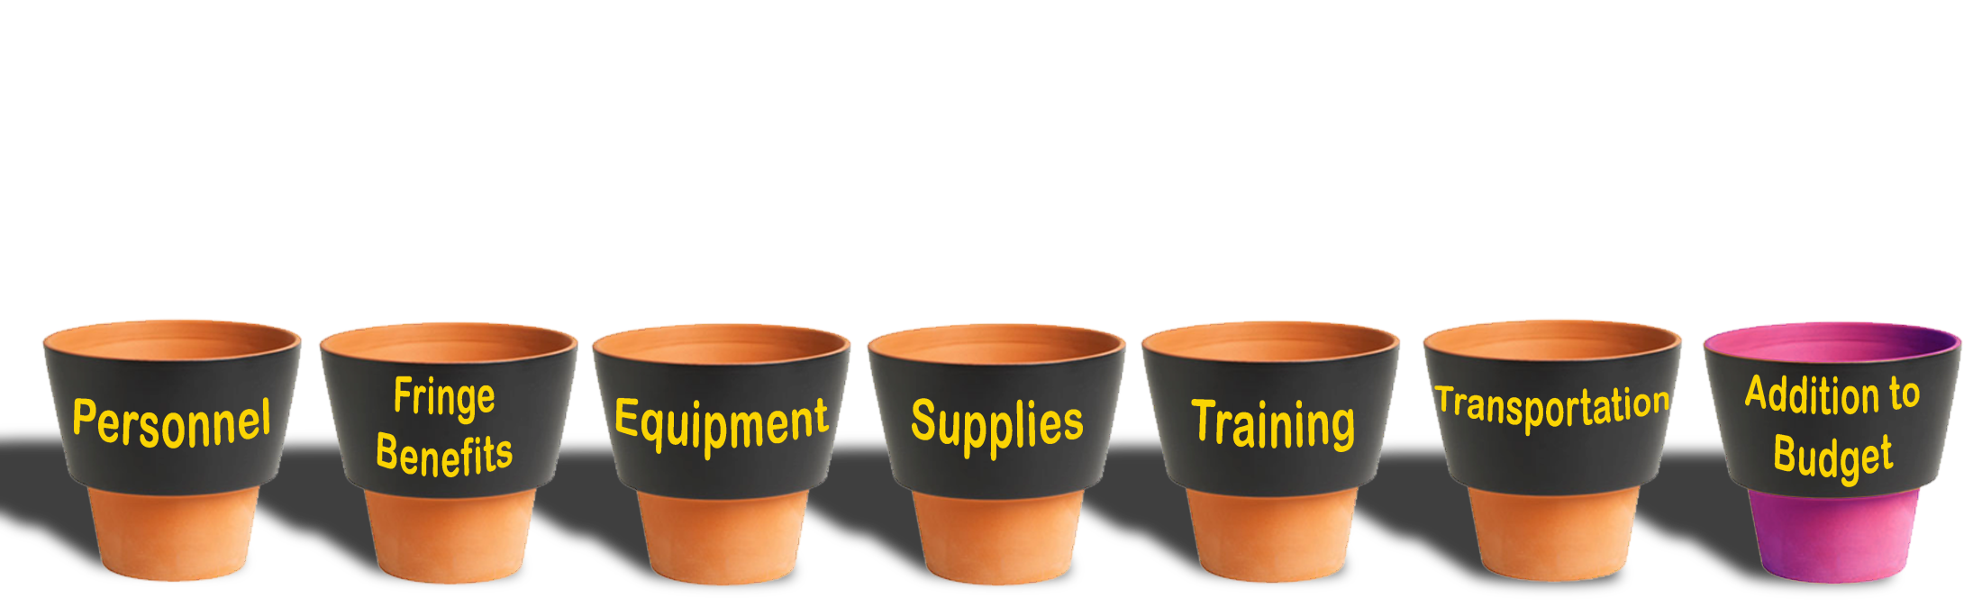
Supplanting
Federal Grant Funds
Supplementing
or Augmenting
OK!
Supplanting or Replacing
Not OK!

Slide 132
Submitting Federal Grants!
www.grants.gov is now the standard portal for almost all federal grant opportunities. You’ll use grants.gov to…
  Find out what grants are available
  Download and review the RFPs
  Submit all proposals through the Work Space (registration required)
A couple of hoops to jump through…..

Slide 133
DUNS Number
All entities applying for a federal grant must have a DUNS (Data Universal Numbering System) number.
Developed by Dun and Bradstreet
Not a Federal Tax Number; it’s like a credit reporting system for any entity seeking government funding/contracts.
Your agency may already have one. Check with your financial people.
Phone 1-866-705-5701
Online at Dunandbradstreet.com
Free – No cost to obtain a DUNS number

Slide 134

Grants.gov
SAM
  Register through “System for Award Management”
AOR
  Designate an “Authorized Organizational Representative”

Slide 135
EO 12372
(Executive Order 12372)
Intergovernmental Review
  SPOC or Single Point of Contact
  If your states adheres to this order, you must notify them when you are submitting a proposal to a federal agency.
  18 states currently require this.
  List can be found at:
  https://www.whitehouse.gov/wp-content/uploads/2017/11/Intergovernmental_-Review-_SPOC_01_2018_OFFM.pdf

Slide 136
States that Currently Participate in E.O. 12372
^{ARIZONA}
^{Matthew Hanson, GPC}
^{Matthew.Hanson@azdoa.gov}
^{ARKANSAS}
^{Tracy L. Copeland}
^{tracy.copeland@dfa.state.ar.us}
^{CALIFORNIA}
^{state.clearinghouse@opr.ca.gov}
^{DELAWARE}
^{Lindsay Lewis}
^{Lindsay.Lewis@state.de.us}
^{DISTRICT OF COLUMBIA}
^{Pat Henry}
^{http://opgs.dc.gov}
^{FLORIDA}
^{Chris Stahl}
^{Chris.Stahl@dep.state.fl.us}
^{IOWA}
^{Debra Scrowther}
^{Debra.Scrowther@iowa.gov}
^{KENTUCKY}
^{Lee Nalley}
^{Lee.Nalley@ky.gov}
^{LOUISIANA}
^{Terry Thomas}
^{Terry.Thomas@la.gov}
^{MARYLAND}
^{Jason Dubow, Manager}
^{Telephone: (410) 767-4490}
^{MICHIGAN}
^{Ed Hug}
^{hug@semcog.org}
^{MISSOURI}
^{Sara VanderFeltz}
^{sara.vanderfeltz@oa.mo.gov}
^{NEVADA}
^{Department of Administration}
^{slambert@admin.nv.gov}
^{NEW HAMPSHIRE}
^{Michele Zydel}
^{michele.zydel@nh.gov}
^{NORTH DAKOTA}
^{Rikki Roehrich}
^{rroehrich@nd.gov}
^{SOUTH CAROLINA}
^{Bonny L. Anderson}
^{banderson@budget.sc.gov}
^{UTAH}
^{Ken Matthews}
^{stategrants@utah.gov}
^{WEST VIRGINIA}
^{Mary Jo Thompson}
^{Mary.j.thompson@wv.gov}
^{Also:}
^{AMERICAN SAMOA}
^{GUAM}
^{NORTH MARIANA ISLANDS}
^{PUERTO RICO}
^{VIRGIN ISLANDS}

Slide 137
Sample grants.gov Application Package
Almost all federal grant programs now utilize the “workspace” on grants.gov for disseminating grant forms and receiving applications.
Download RFPs and SF-424 in pdf format using “Preview” link to look at the opportunity.
The “Apply” link will ask you to log in so you can begin your online application in workspace.

Slide 138
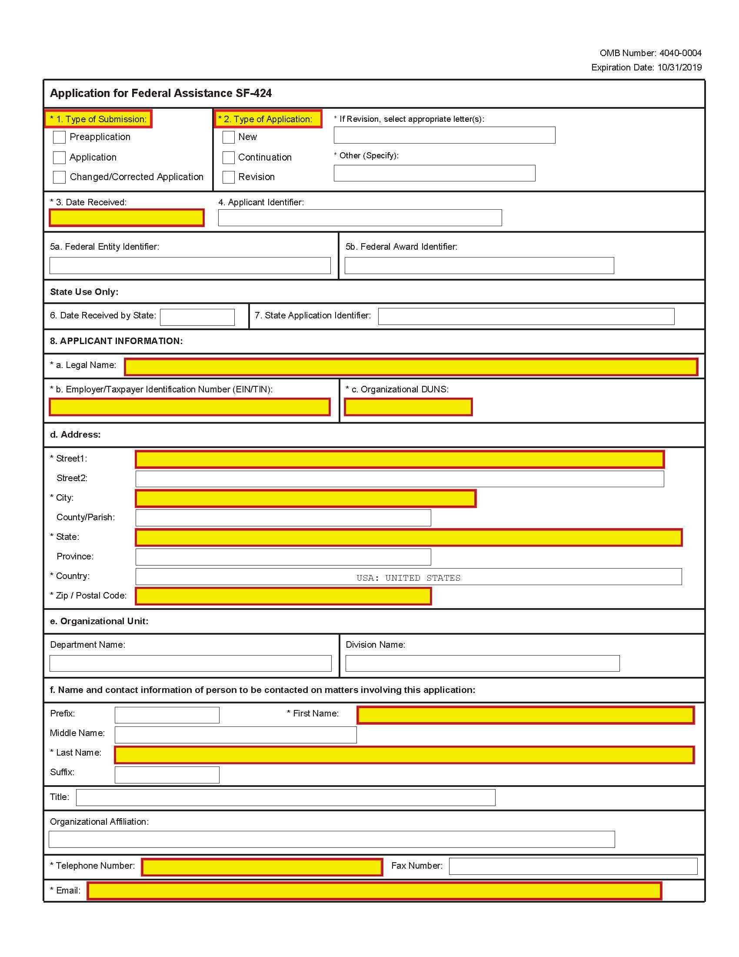

Slide 139
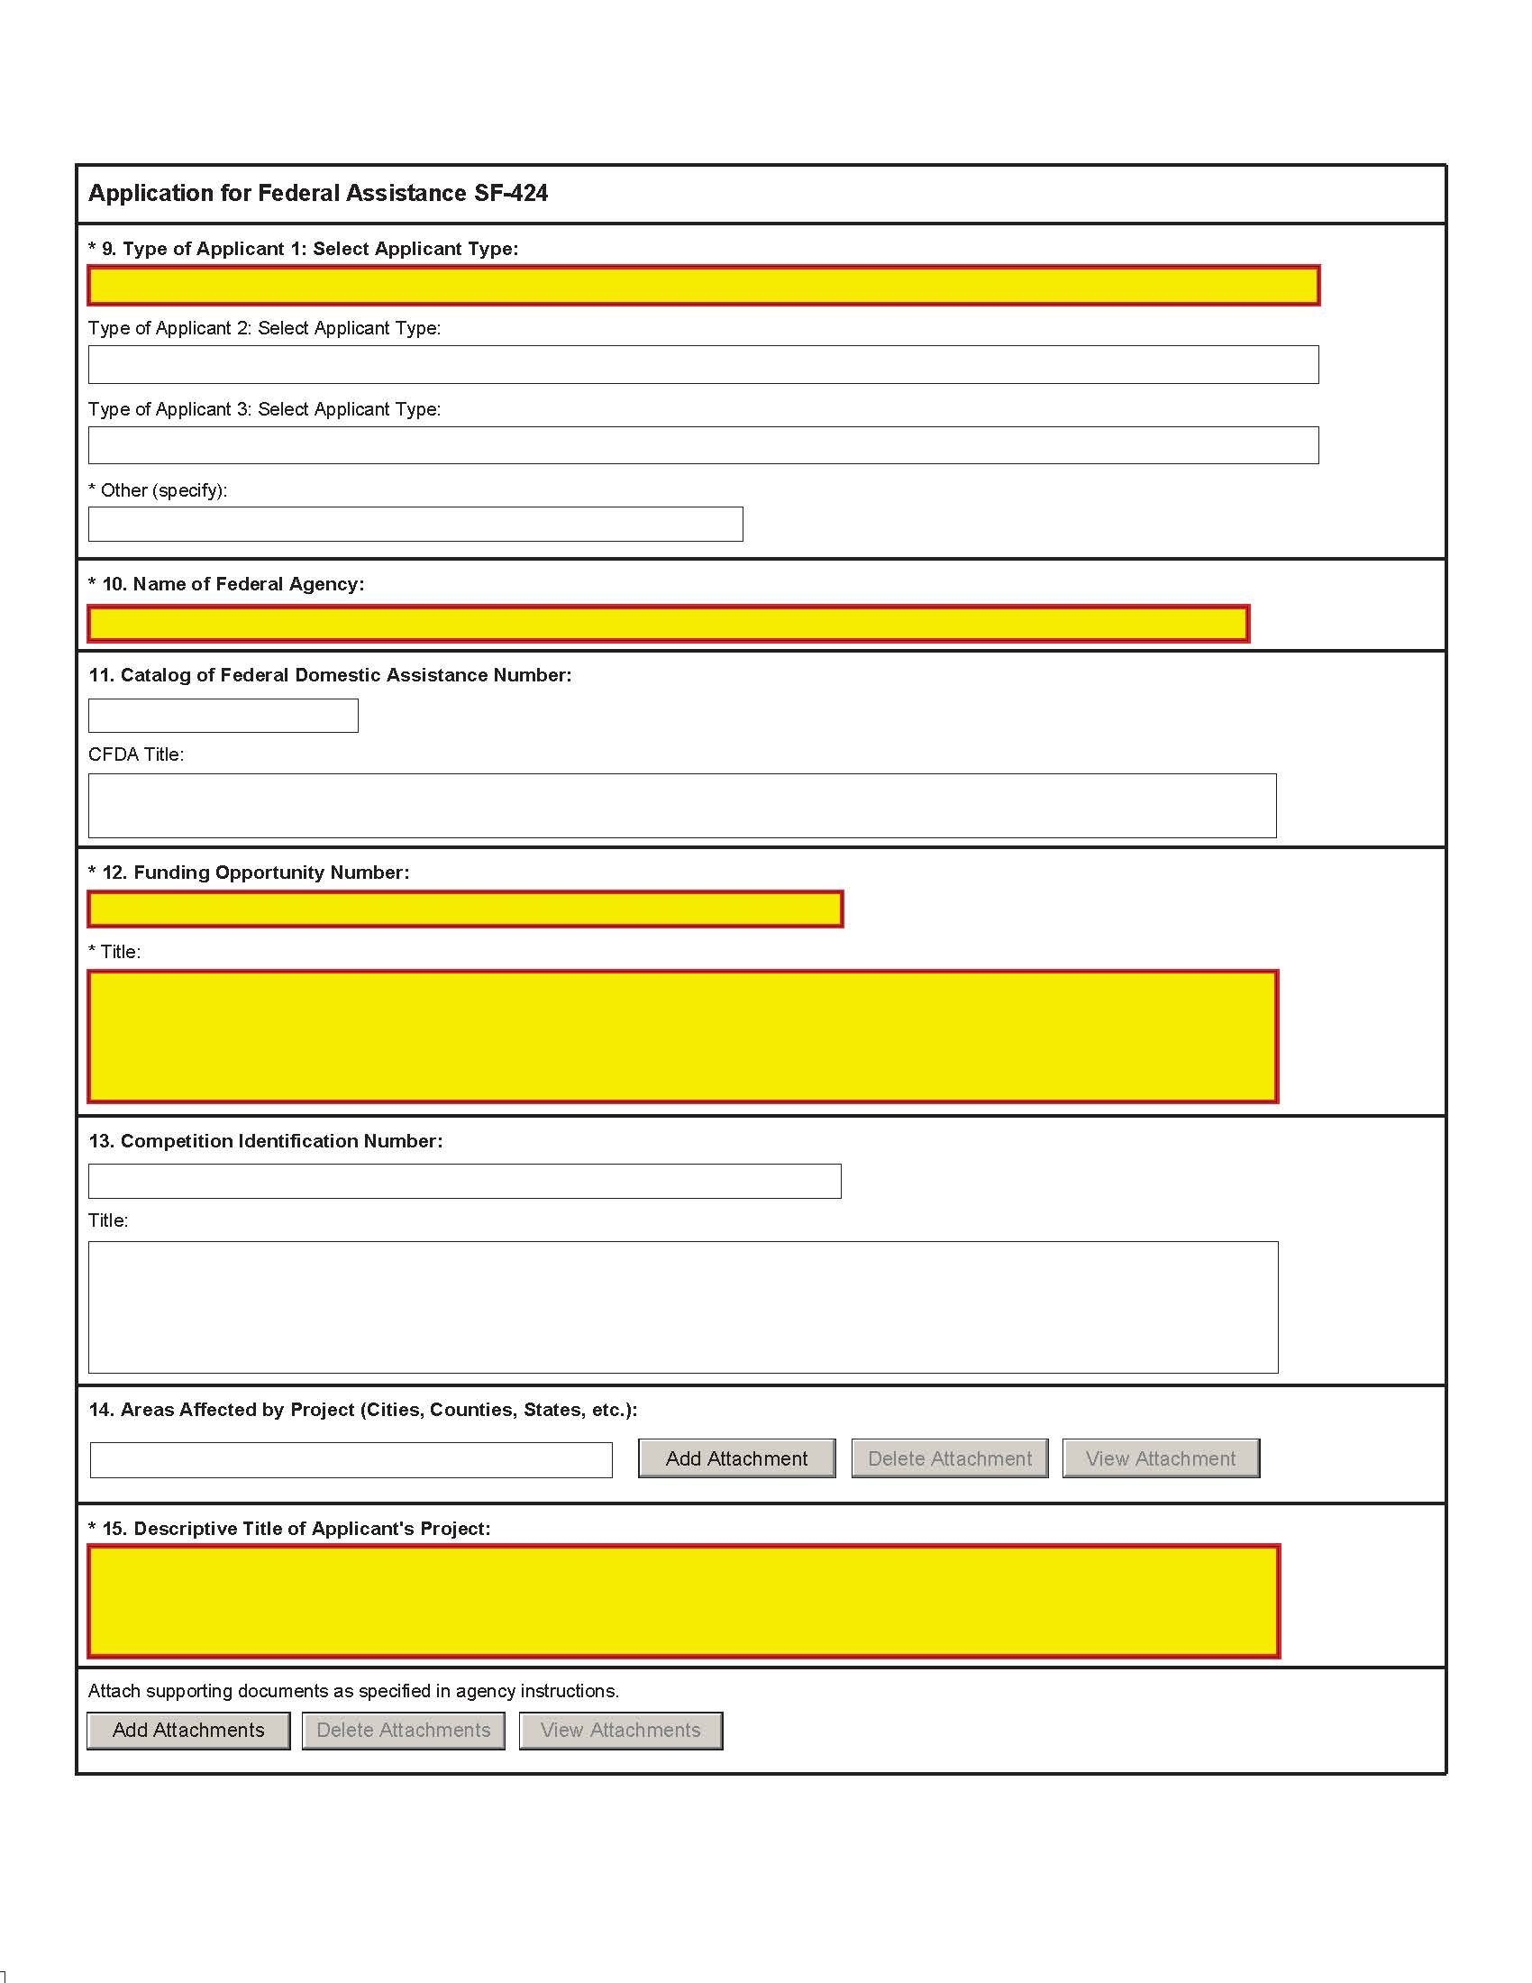

Slide 140
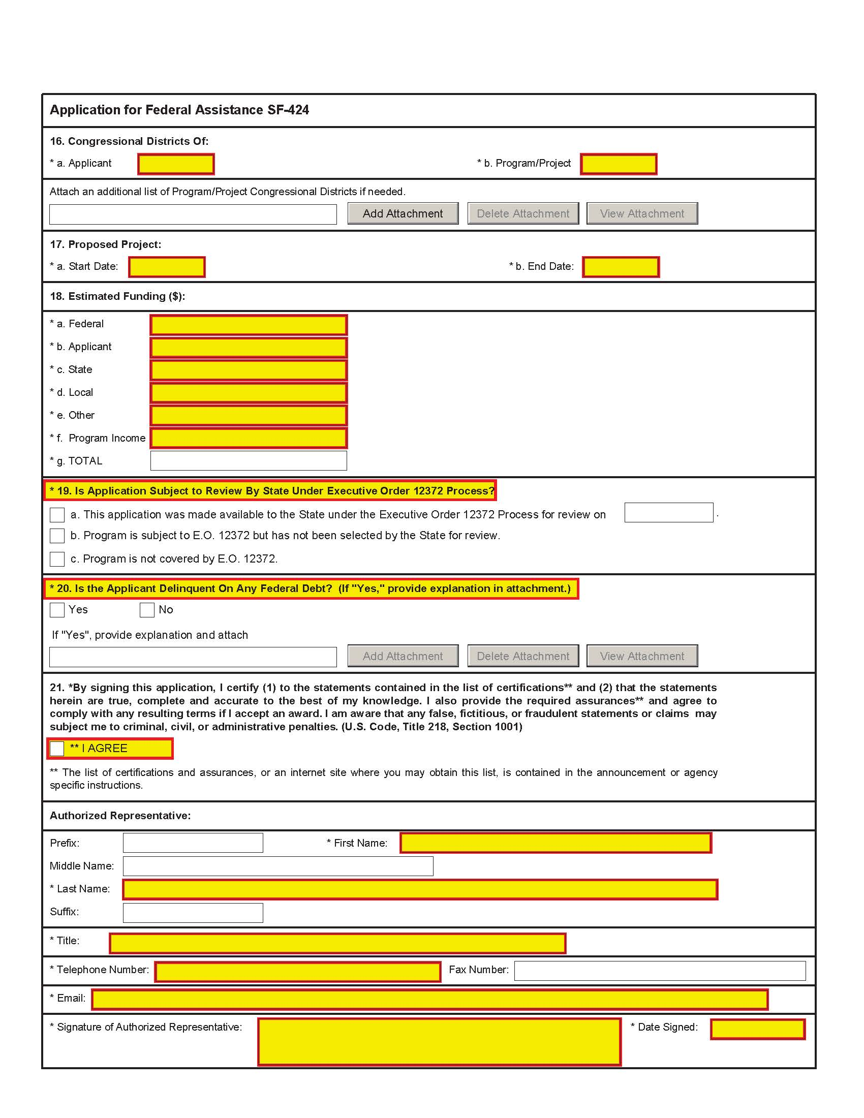

Slide 141
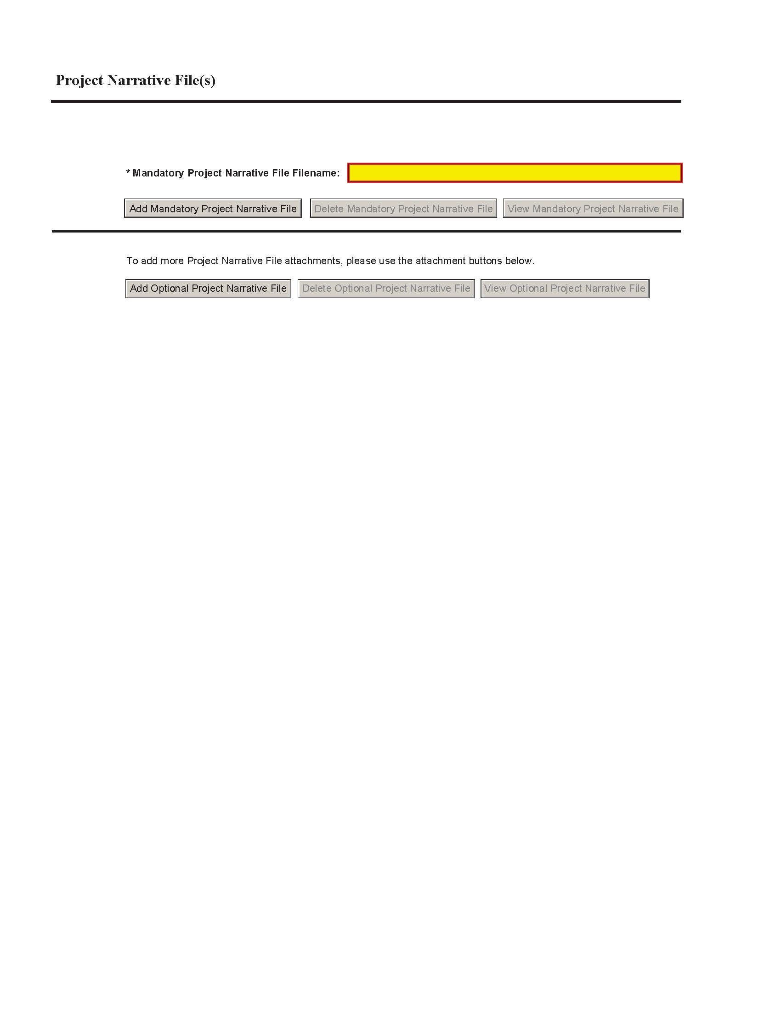

Slide 142
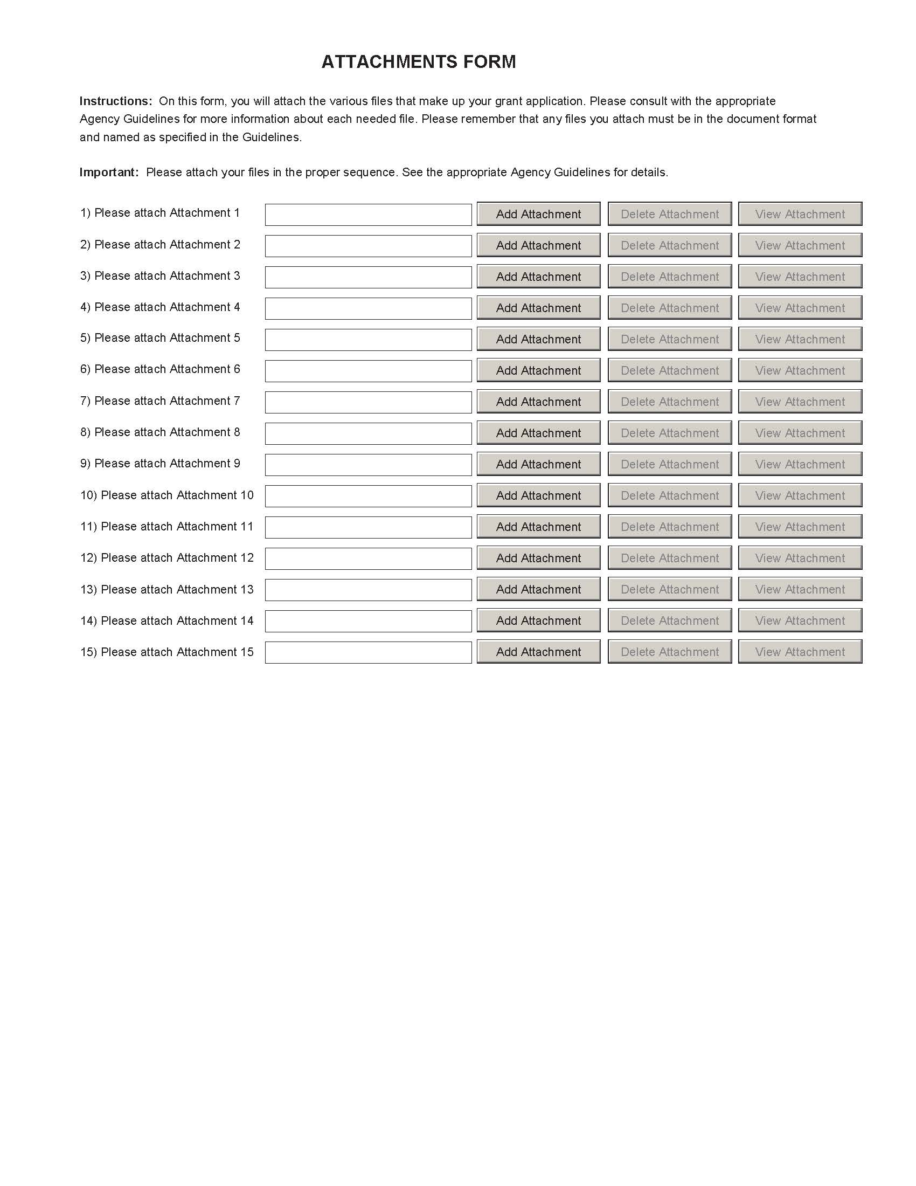

Slide 143
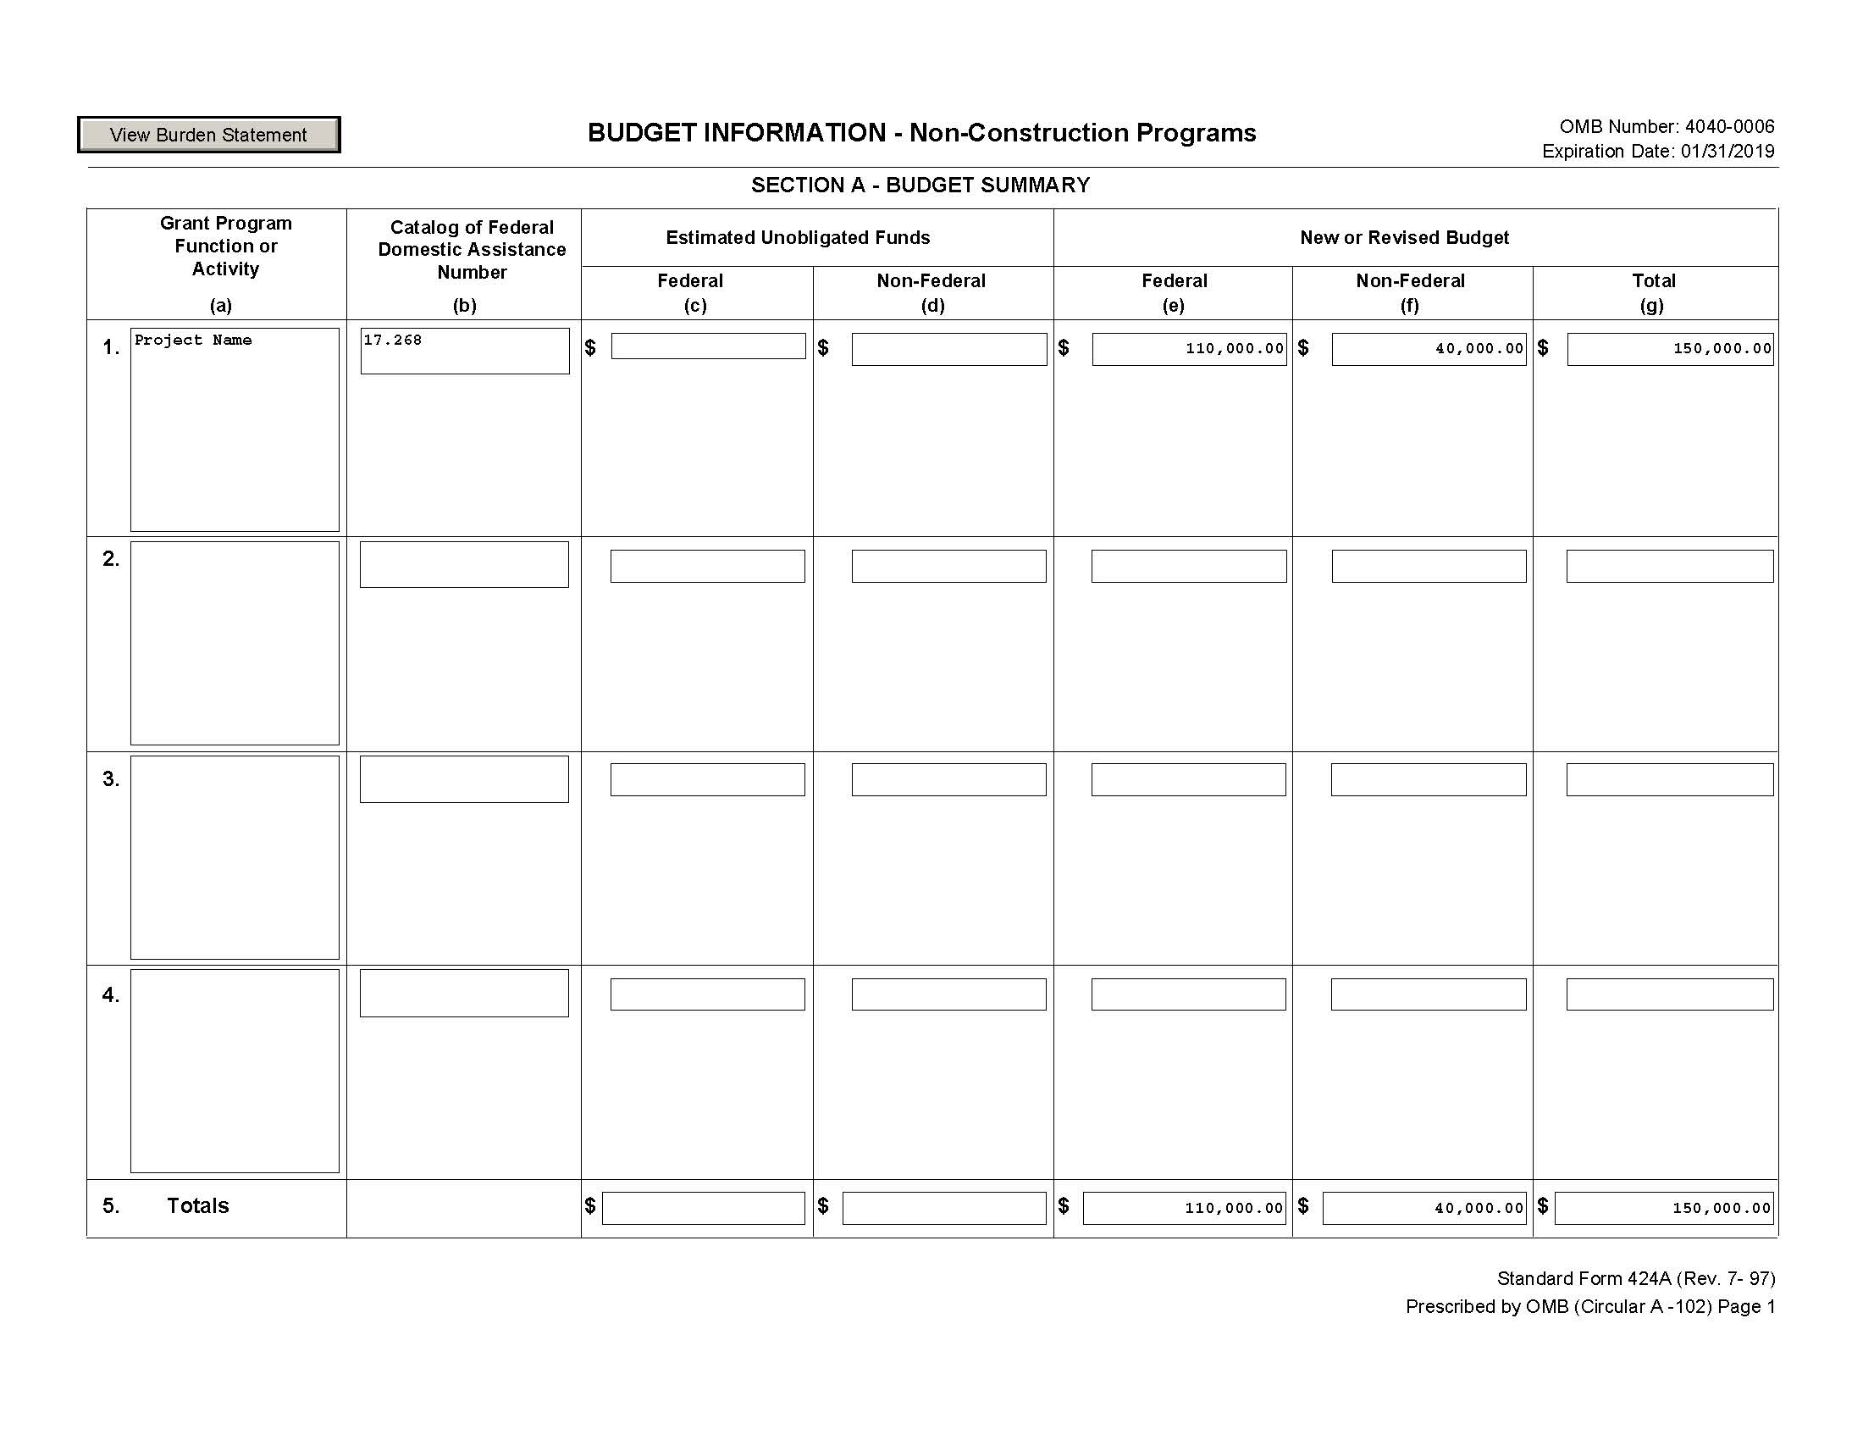

Slide 144
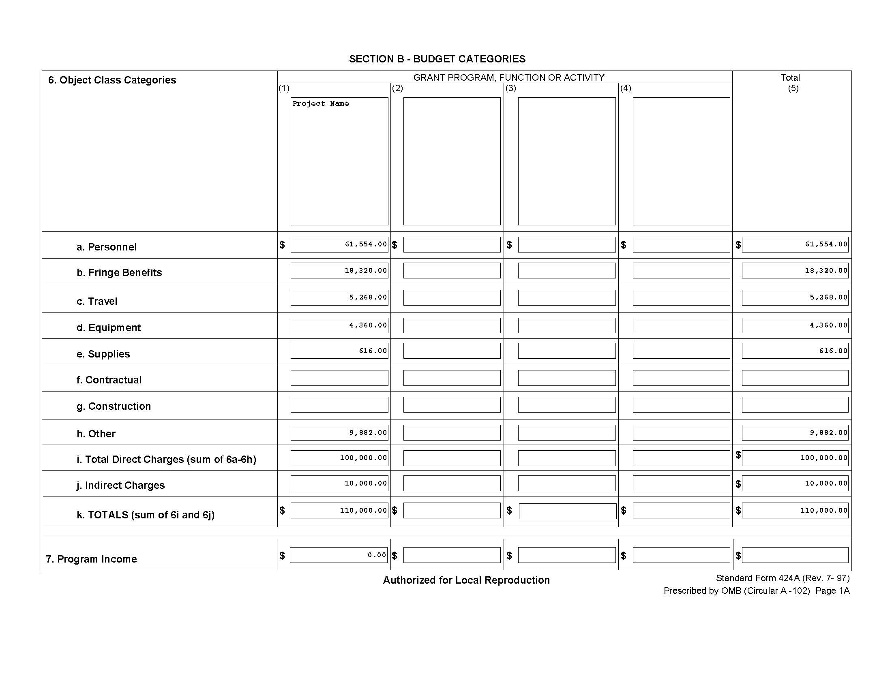

Slide 145
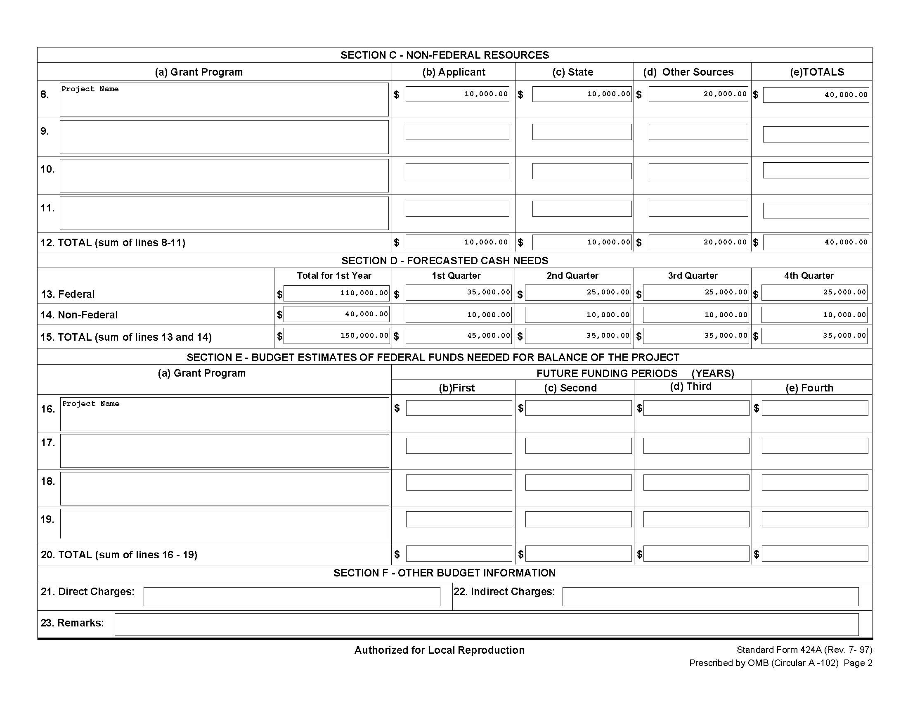

Slide 146
Submission requirements:
SAM accepts 4 file formats as attachments
    Text
    pdf.
    Word
    Excel
Warning: Name your file attachments the name designated in the RFP!

Slide 147
Tips for Submitting Through grants.gov
Register with grants.gov ASAP and become familiar with the application process (Workspace) well in advance of your deadline.
If you submit early and find you made a mistake you can resubmit up until the deadline.
Grants.gov has a good help desk to resolve issues, but they can’t save you if you miss the submission deadline.

Slide 148
Webinar on Workspace
I highly recommend you review the Workspace webinar on grants.gov before submitting your first proposal.
  https://www.grants.gov/web/grants/applicants/workspace-overview.html

Slide 149
How Do I Write My First Proposal?
Follow the RFP instructions. Outline it and work off the outline.
By Committee: Assign each person a different section or question.
Compose your response within an electronic copy of the RFP

Slide 150
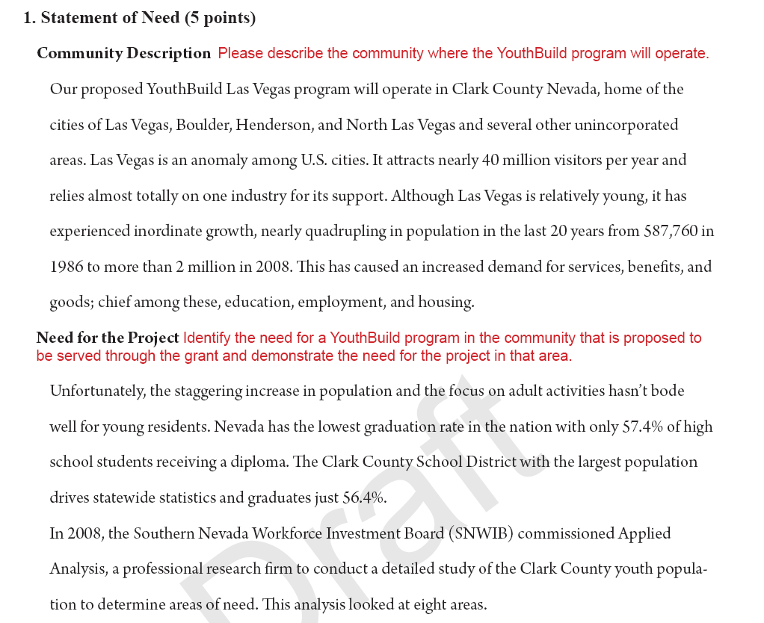

Slide 151
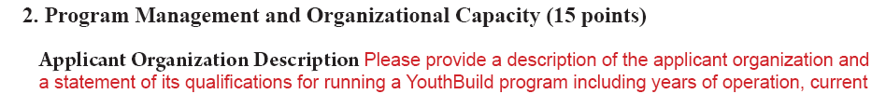
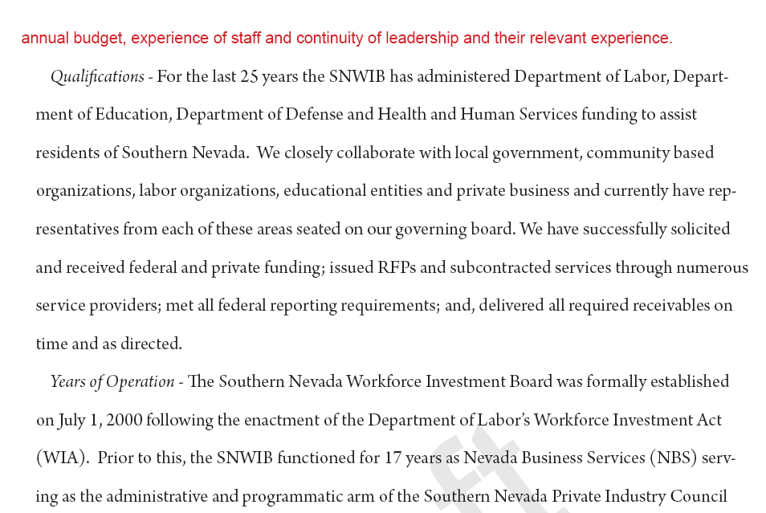

Slide 152
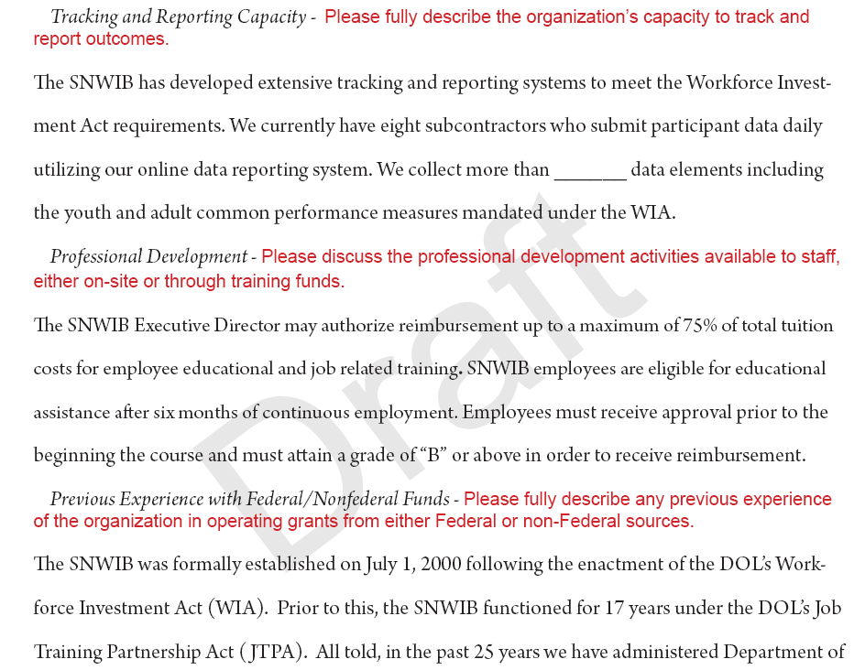

Slide 153
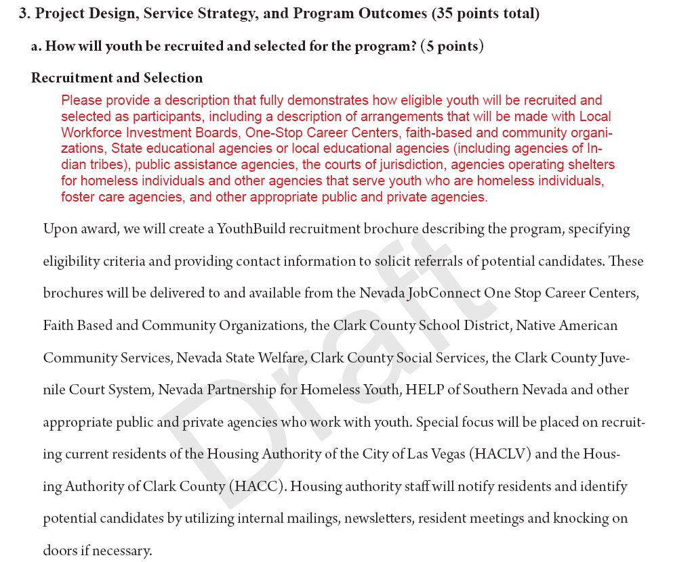

Slide 154
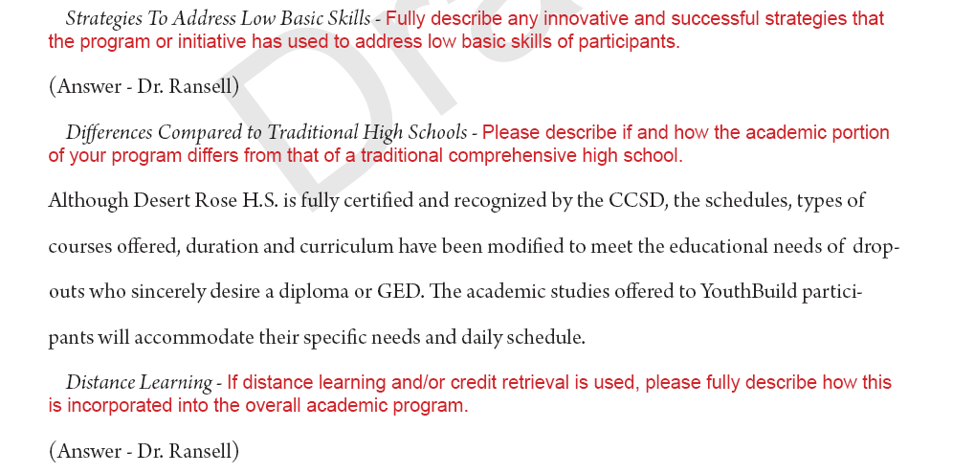

Slide 155
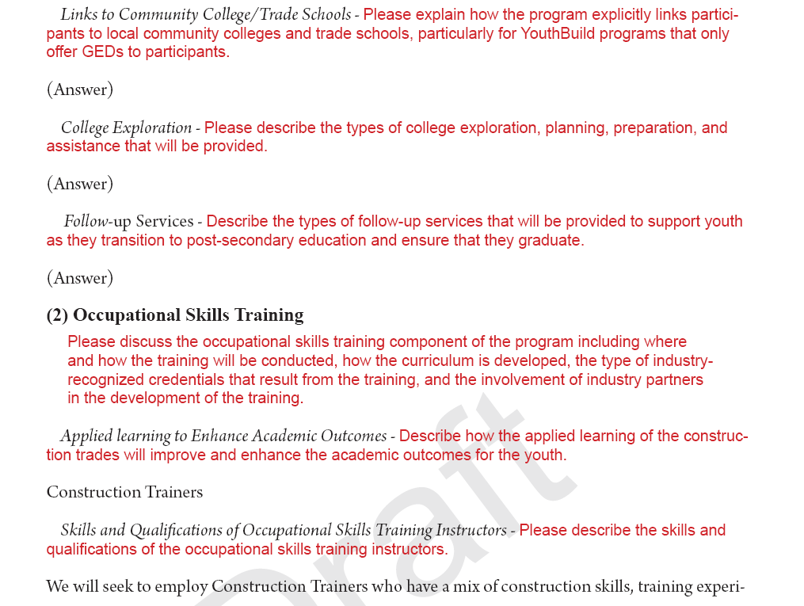

Slide 156
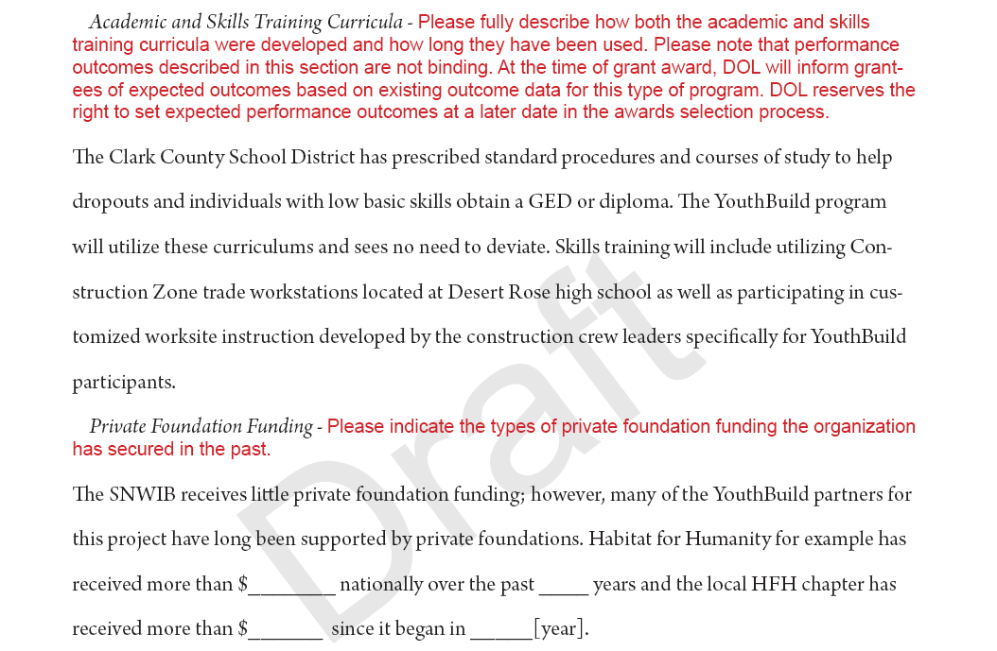

Slide 157
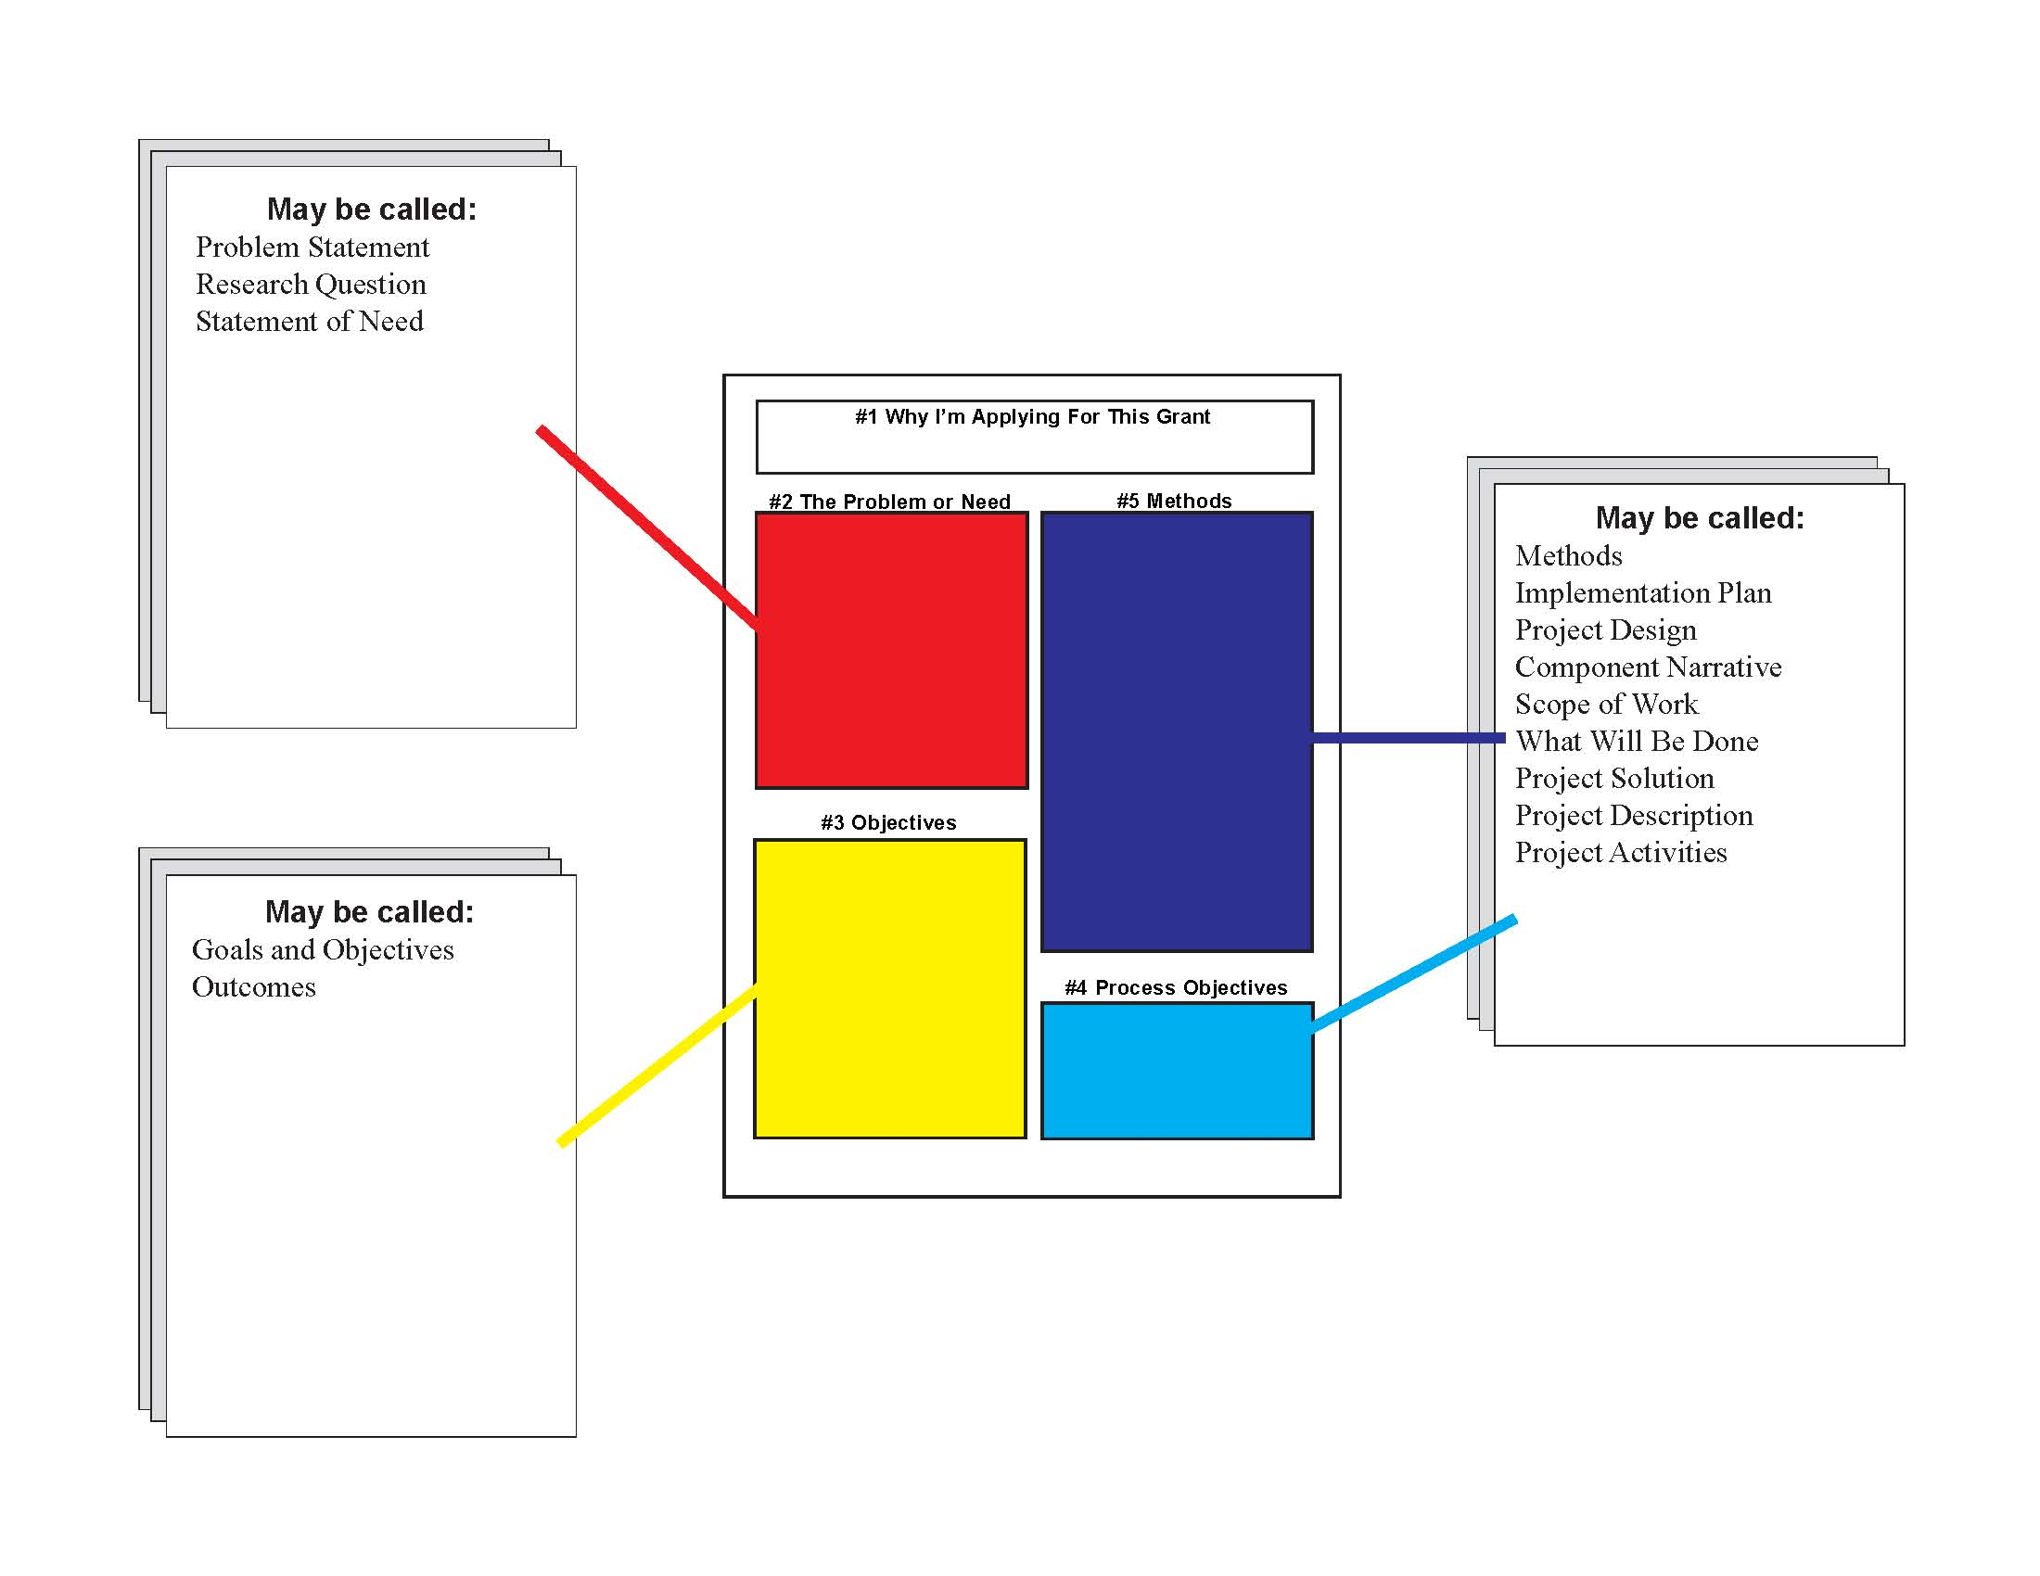

Slide 158
Summary (or Abstract)
Chapter 7

Slide 159

The Summary is…
The essence of all our desires condensed into a compelling sales pitch!

Slide 160
Can you condense this information into a single page? Half a page?
Who you are (Credibility)
What you are concerned about (Problem/Needs Statement)
What you propose to do (Goals and Objectives)
How you propose to do it (Methods)
When will you start and finish (Methods/Timeline)
Where will the project take place (Methods/Location)
How much will the project cost and how much you’re requesting (Budget/Request)
How much you have already or intend to invest (Budget/Match)

Slide 161
Don’t Forget the Ask!
The ask is an actual statement that must be included in your proposal. It says:
  Who you are!
  How much you want!
  What it is for!
The Jefferson County School District requests $600,000 to establish a children’s nutrition program.
Signature Productions requests $100,000 to stage 3 musical plays during 2019.
Works For Vegas requests $1.1 million to conduct a YouthBuild program.
TriCity Animal Shelter requests $300,000 to establish a spay and neuter clinic.

Slide 162
Finally…Where’s the Money?
Links to resources may be found at the GrantwritingUSA alumni forum:
www.grantwritingusa.com/grads
Keyword is “friendship”

Slide 163
What to do now…
Begin building your credibility file
Create a file listing recurring costs (fringe benefit rates, computer purchases IT, etc.)
Write your Problem Statement
Gather Resumes
Anticipate release dates of RFPs by determining when the last RFPs were issued.

Slide 164
What to do now…
Determine what money will fund - the problem
Estimate the measurable outcomes of your project?
Determine what impact this $ will have on the problem.
Budgets usually have to wait for the RFP, but begin developing a relationship with your finance people now.

Slide 165
What to do now…
Research what are other people doing in your field. Borrow the best practices.
Start investigating the possibility of using outside evaluators.
Seek opportunities to meet and develop potential relationships with people who have access to, or can help you get funding (schmooze factor).

Slide 166
What to do now…
Start researching potential grants
CDFA is #1 place for Federal resources and grants
Look at Foundation Center Search for 990 forms.

Slide 167
What to do now…
Based on your 990 search, make a list of private foundations in your area
Browse their websites (or other sources) to determine their funding priorities
Send a query letter asking them if they would consider a formal proposal from you

Slide 168
Maslow’s Hierarchy of Needs
Self-actualization - to become everything that one is capable of becoming
Esteem - All humans have a need to be respected and to have self-esteem and self-respect.
Love and belonging - Friendship, Intimacy and Family
Safety needs - Personal security, Financial security, Health and well-being
Physiological needs - The literal requirements for human survival

Slide 169
Arguments that will increase your chances of funding
Aristotle, and later Cicero, divided arguments into three categories:
  ^{Logos}
  ^{Pathos}
  ^{Ethos/Credos}

Slide 170
Logos
An appeal to reason or logic.
Uses generally accepted propositions to derive specific conclusions.
Proposals that use logos promise the funder is getting the best product.
The Comfort Agency has been providing these services for years and has a stellar track record of helping more than 5,000 clients learn to read.

Slide 171
Pathos
Appeal to emotion
Presenting the topic in a way that evokes strong emotions in the audience.
Pathos ads are not logical; instead, they tap into people's desires to be loved and kept safe.
By funding our program, we will reduce the sexual and emotional abuse of children.

Slide 172
Ethos/Credos
Appeal utilizing a person or organization’s character or credibility.
How the character and credibility of a speaker can influence an audience to consider him/her to be believable.
If a person wears Nike shoes, they will be as good an athlete as Michael Jordan.
Our organization has been recognized by the U.S. commission of excellence as the best in the country.

